Slide 1
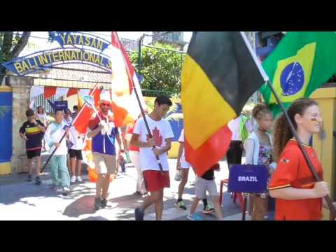
Welcome to Bali Island School
Engaging and empowering globally-minded, confident learners to reach their utmost potential in an active, creative and respectful learning community

Slide 2
BIS Values
Our values are derived from the IB Learner Profile. Through these attributes, we embed the concept of internationalism and provide opportunities for leadership within our community and in our curriculum. All members of the BIS community strive to be: Reflective Risk-takers Knowledgeable Balanced Inquirers Thinkers Principled Communicators Caring Open-minded

Slide 3
Expectations
•Attendance
•Attire
•Behavior
•Homework – Outcomes Based School
•Parent Involvement
•ManageBac/Google Classroom

Slide 4
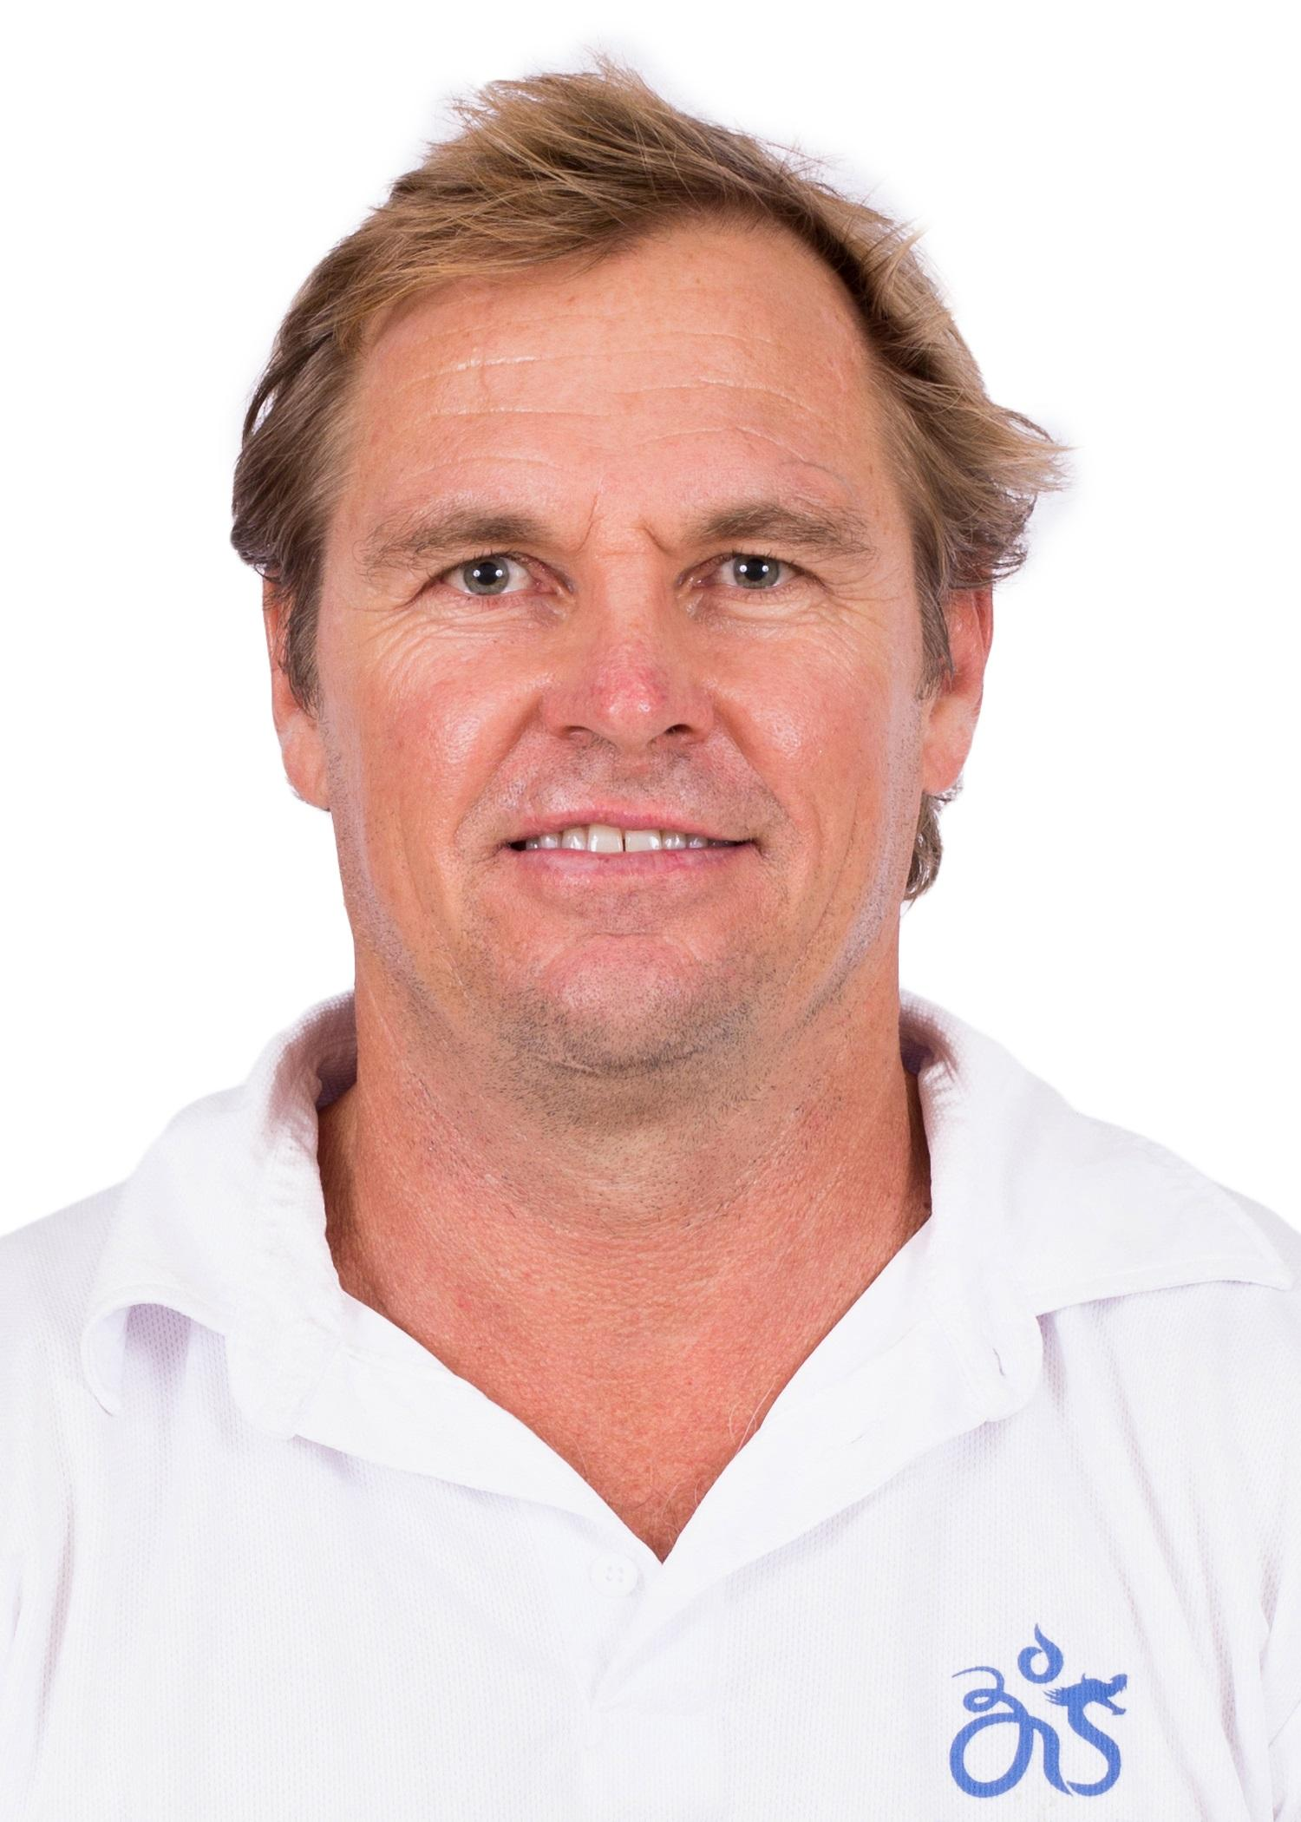
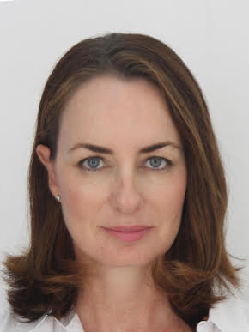
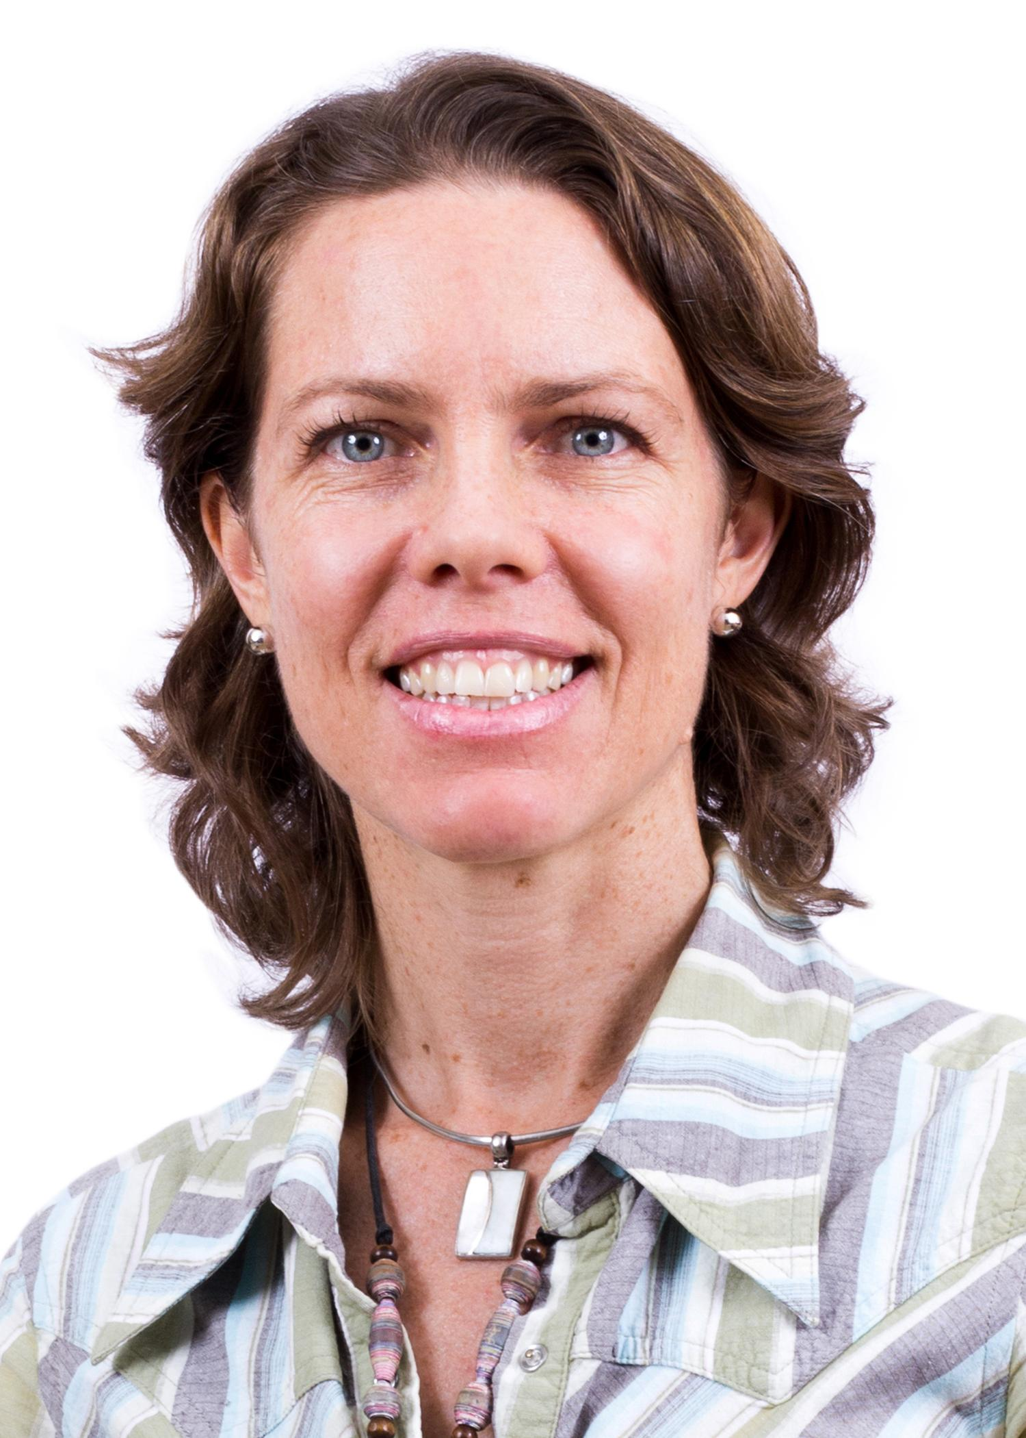
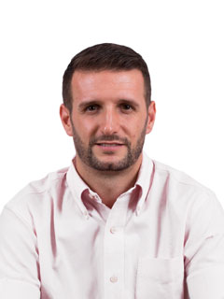
Introducing……
Mr. Hamish Sutherland
Student Activities Coordinator
Ms. Karin Holley
School Counselor
Ms. McLay
MYP Coordinator
Mr. Wood
DP Coordinator

Slide 5
The Middle Years Programme (Grades 6 to 10) (Year 1 - 5)
The MYP has been designed as a comprehensive curriculum framework that provides academic challenge and develops the life skills of students from the ages of 11 to 16.

Slide 6
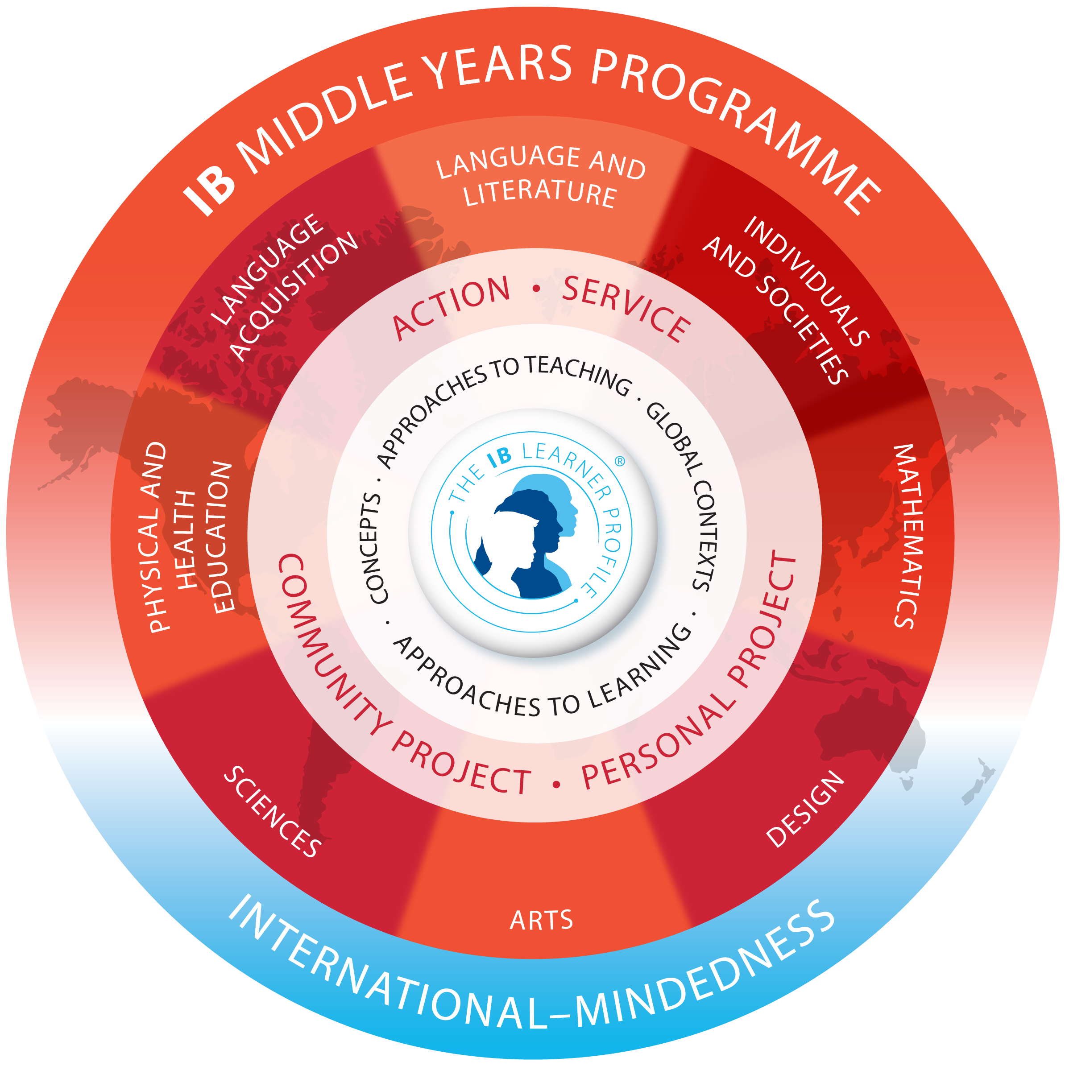
What the MYP offers students
Students that participate in the MYP:
build confidence in managing their own learning
learn by doing, connecting the classroom to the larger world
develop an understanding of global challenges and a commitment to act as responsible citizens.
become creative, critical and reflective thinkers

Slide 7
Parents How can you help?
Expect homework. Provide a workplace for homework to occur. Set a daily routine for your child to sit and complete. Check in
Assessment tasks. Insist you see you see your child’s assessment tasks, provide feedback but do not do it for them.
Organisation. Help them to stay organised. Make sure your child has a method to organise him/herself.
A good night’s sleep - 10-17 year olds need 8-10 hours sleep per night

Slide 8
Do you want to know more?
5 September: MYP parent information session- learn more about the curriculum
BIS eNews for articles related to the MYP
Parent Information Sessions on the MYP
IB Programmes Handbook
Contact the MYP Coordinator on mypcoordinator@baliis.net

Slide 9
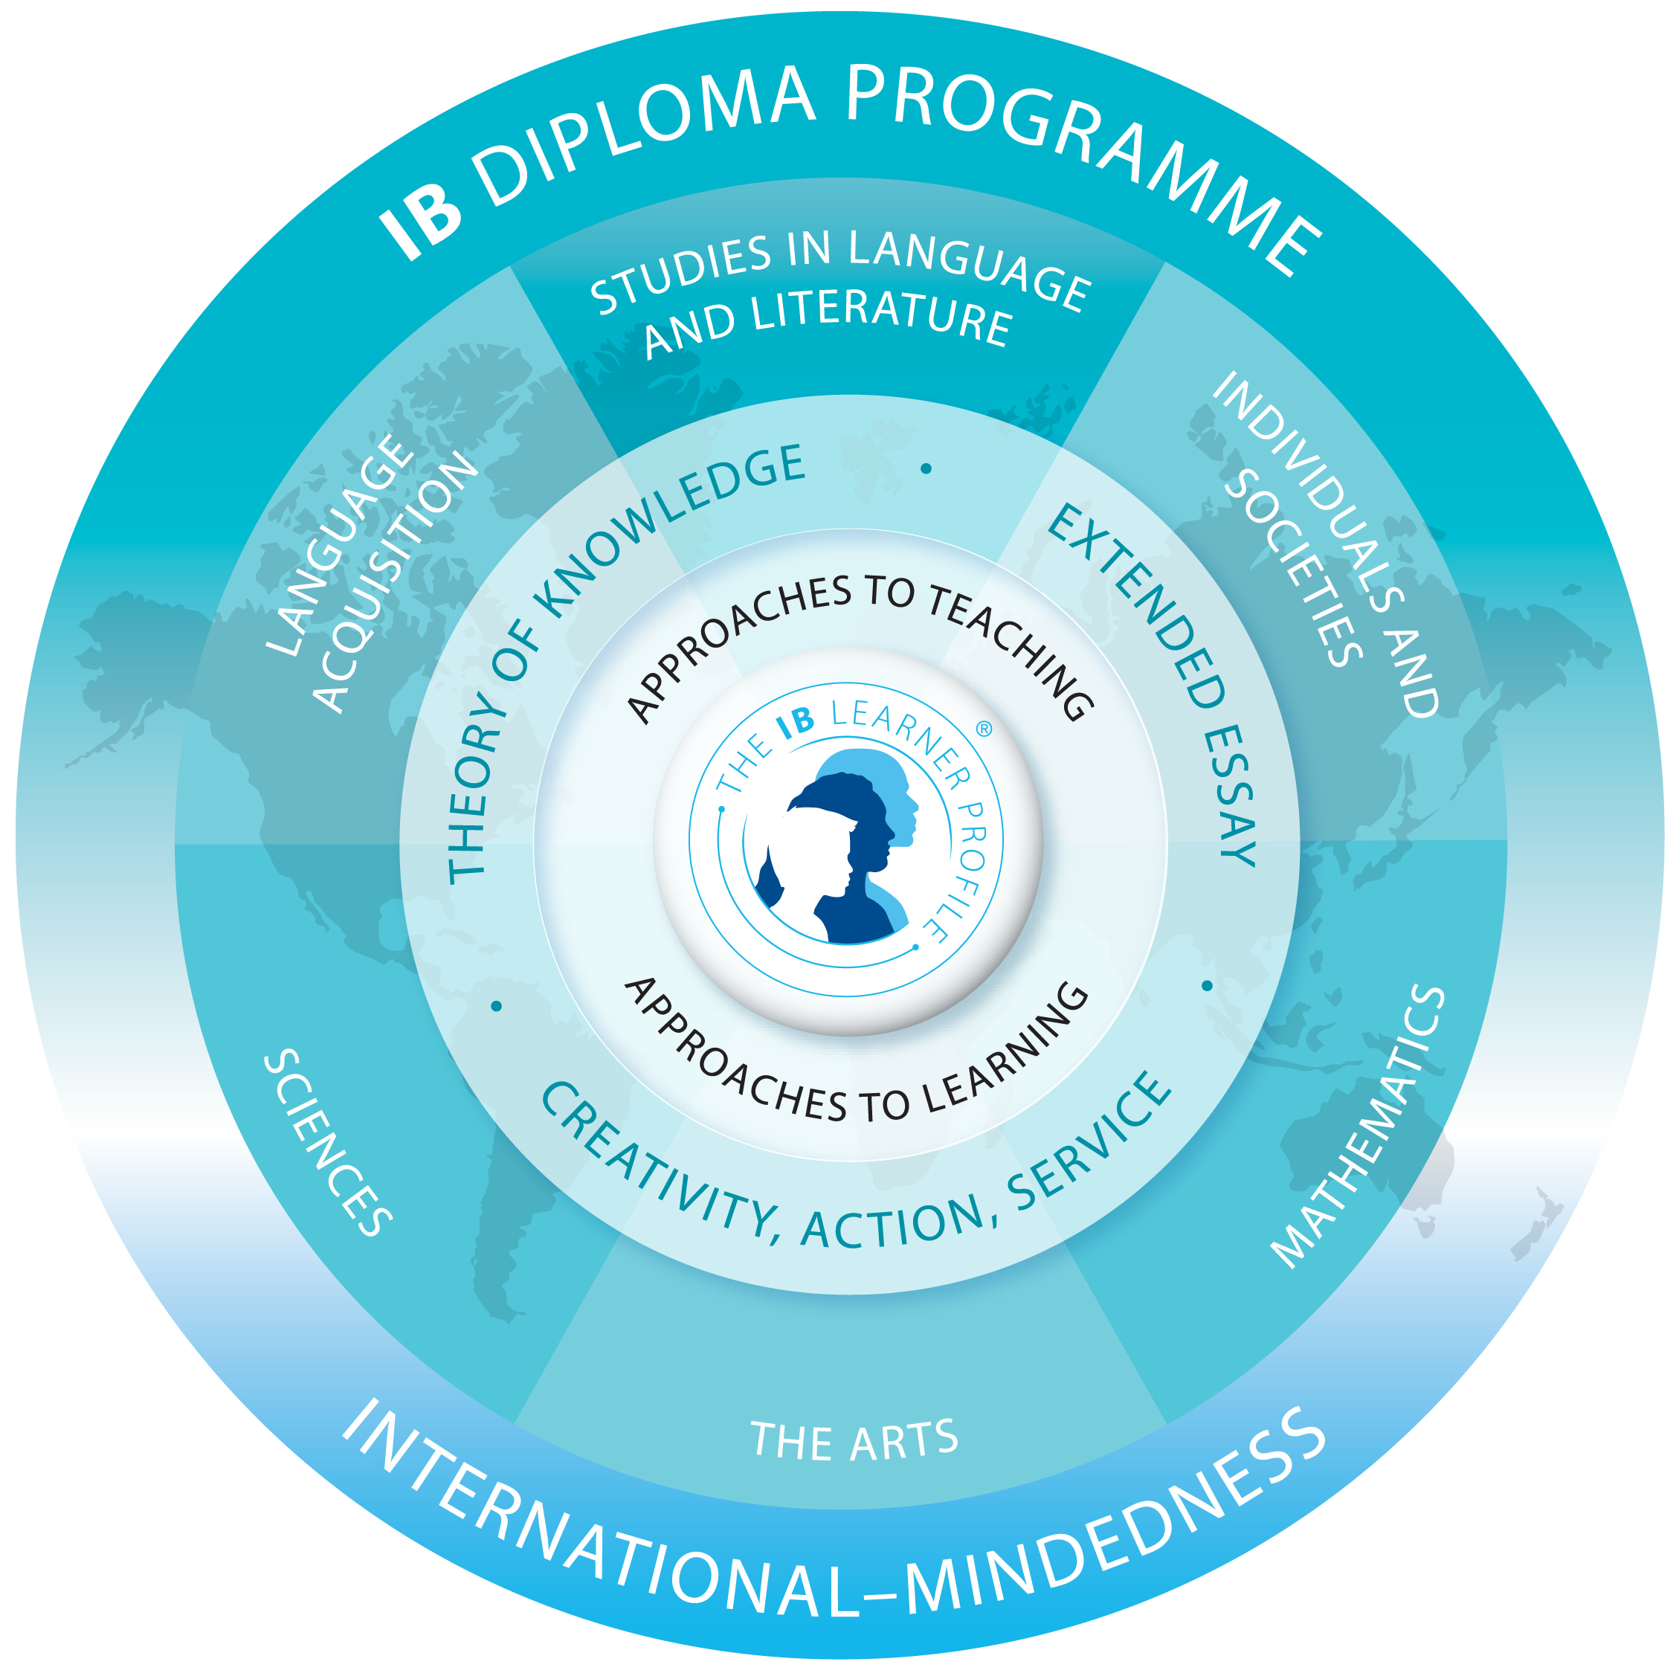

Slide 10
Do you want to know more?
11 September: DP parent information session- learn more about the curriculum
BIS eNews for articles related to the DP
IB Programmes Handbook
Contact the DP Coordinator on dpcoordinator@baliis.net

Slide 11
Counseling Services
•Course Selection / College Admissions Advising
•Standardized Testing
•Scheduling
•Individual/Group counseling (Friendship, Social Skills, Stress Management, Test Taking)
•Admissions
•Peer Mediation
•Crisis planning/prevention
•Transition/Promotion

Slide 12
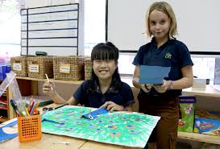
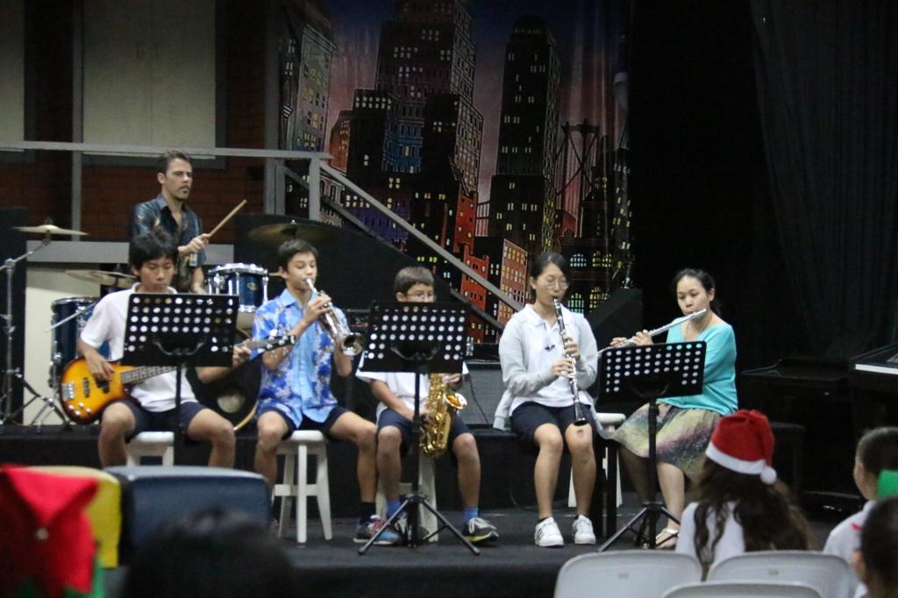
Secondary School Program
•Community Service
•BSSA/IISSAC
•Band/Singing
•Art
•Drama
•Over 40 clubs and Activities
•EOTC

Slide 13
Communication
•Google Classroom
•ManageBac
•Enews
•BIS Website- Supply List, Handbook etc.
•Weekly Parent Newsletter
•BIS 31st Anniversary/International Day-September, 4th

Slide 14
Questions…..Answers
Where do I go?
4:25 Start in your first block class. Class is 10 minutes, you then have 5 minutes to get to the next class.
**If you are lost we have STUCO ambassadors available or come to the office and we will take care of you from there!

Slide 15
Have a Wonderful Evening

