Slide 1
BALI ISLAND SCHOOL
AFTER SCHOOL ACTIVITIES

Slide 2
Primary
After School Activities
TERM 2

Slide 3
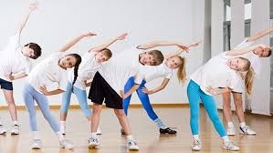
Morning Aerobics
Instructor | Sam Watson
Description | Let’s move your body, every Monday & Wednesday morning
Pillar | Sport
Max. Participant | Open
Day & Time | Monday & Wednesday, 7.30 - 7.45AM
Applicable Grade | Kindy - 5
Cost | No
Location | MPR

Slide 4
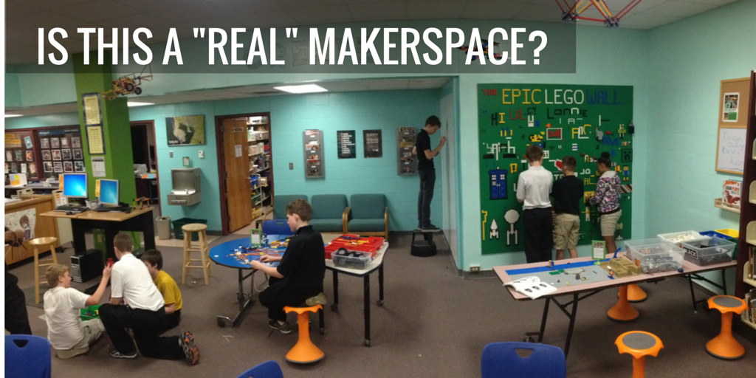
Lunch Makerspace
Instructor | Craig Eldred
Description | Our first Makerspace ASA will be run for the Grade 1-3 students. Students will create, tinker, explore and discover using a range of tools and materials. We’ll pull old computers and printers apart, design & build vehicles, create mazes & constructions & more.
Pillar | Arts
Max. Participant | 16
Day & Time | Monday, 12.40 - 1.10PM
Applicable Grade | 1 - 3
Cost | No
Location | Library Classroom

Slide 5
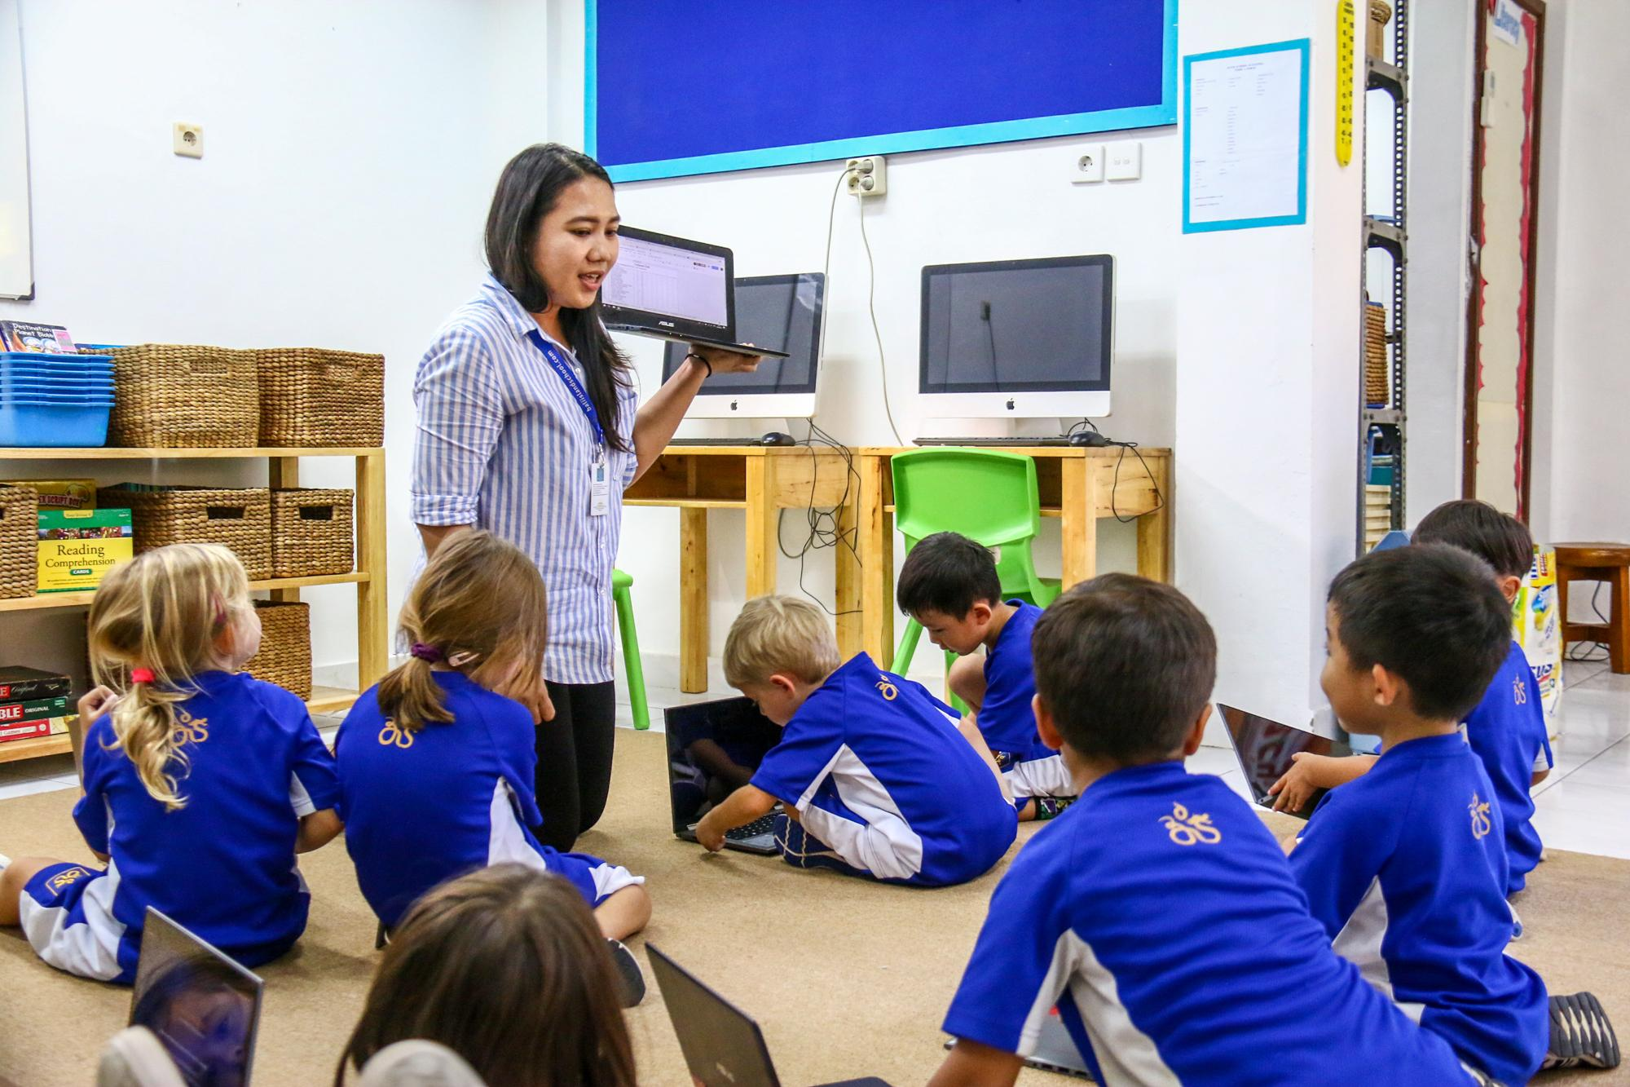
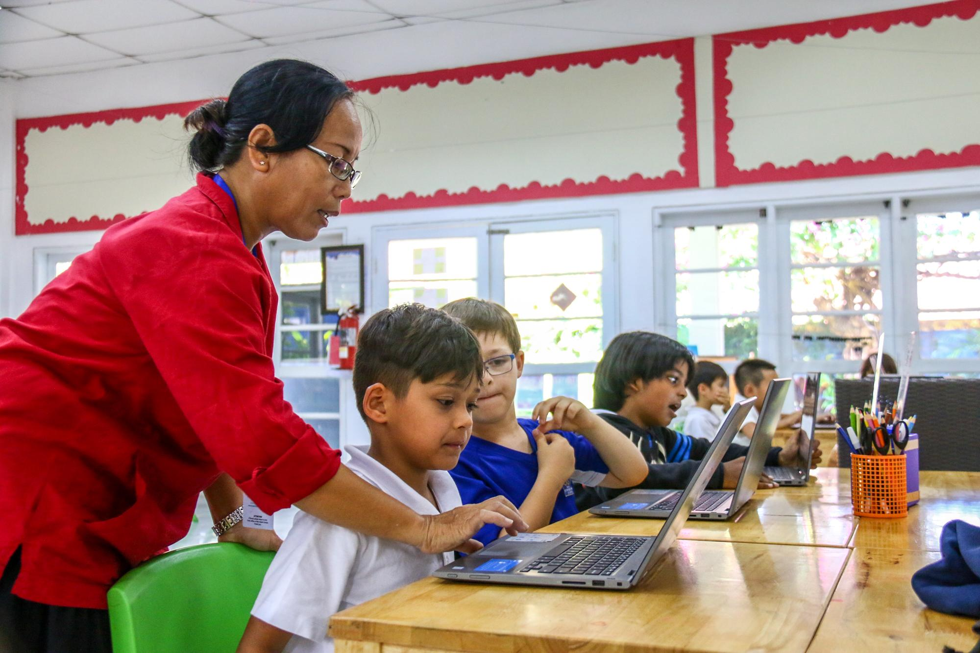
Computer Club
Instructor | Ketut Indah & Ayu Kristiandayanti
Description | Improve your computer skills; do RAZ-kids, Lexia, Mathletics; Educational games;practice typing skills; and explore new programs
Pillar | Co-Curicullar
Max. Participant | 16
Day & Time | Monday, 3 - 4 PM
Applicable Grade | Kindy - 3
Cost | No
Location | Grade 4 Classroom

Slide 6
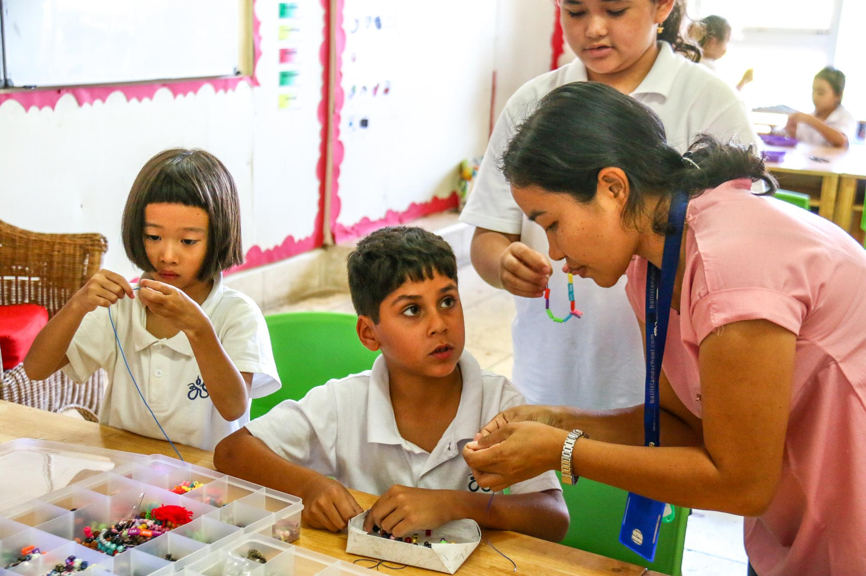
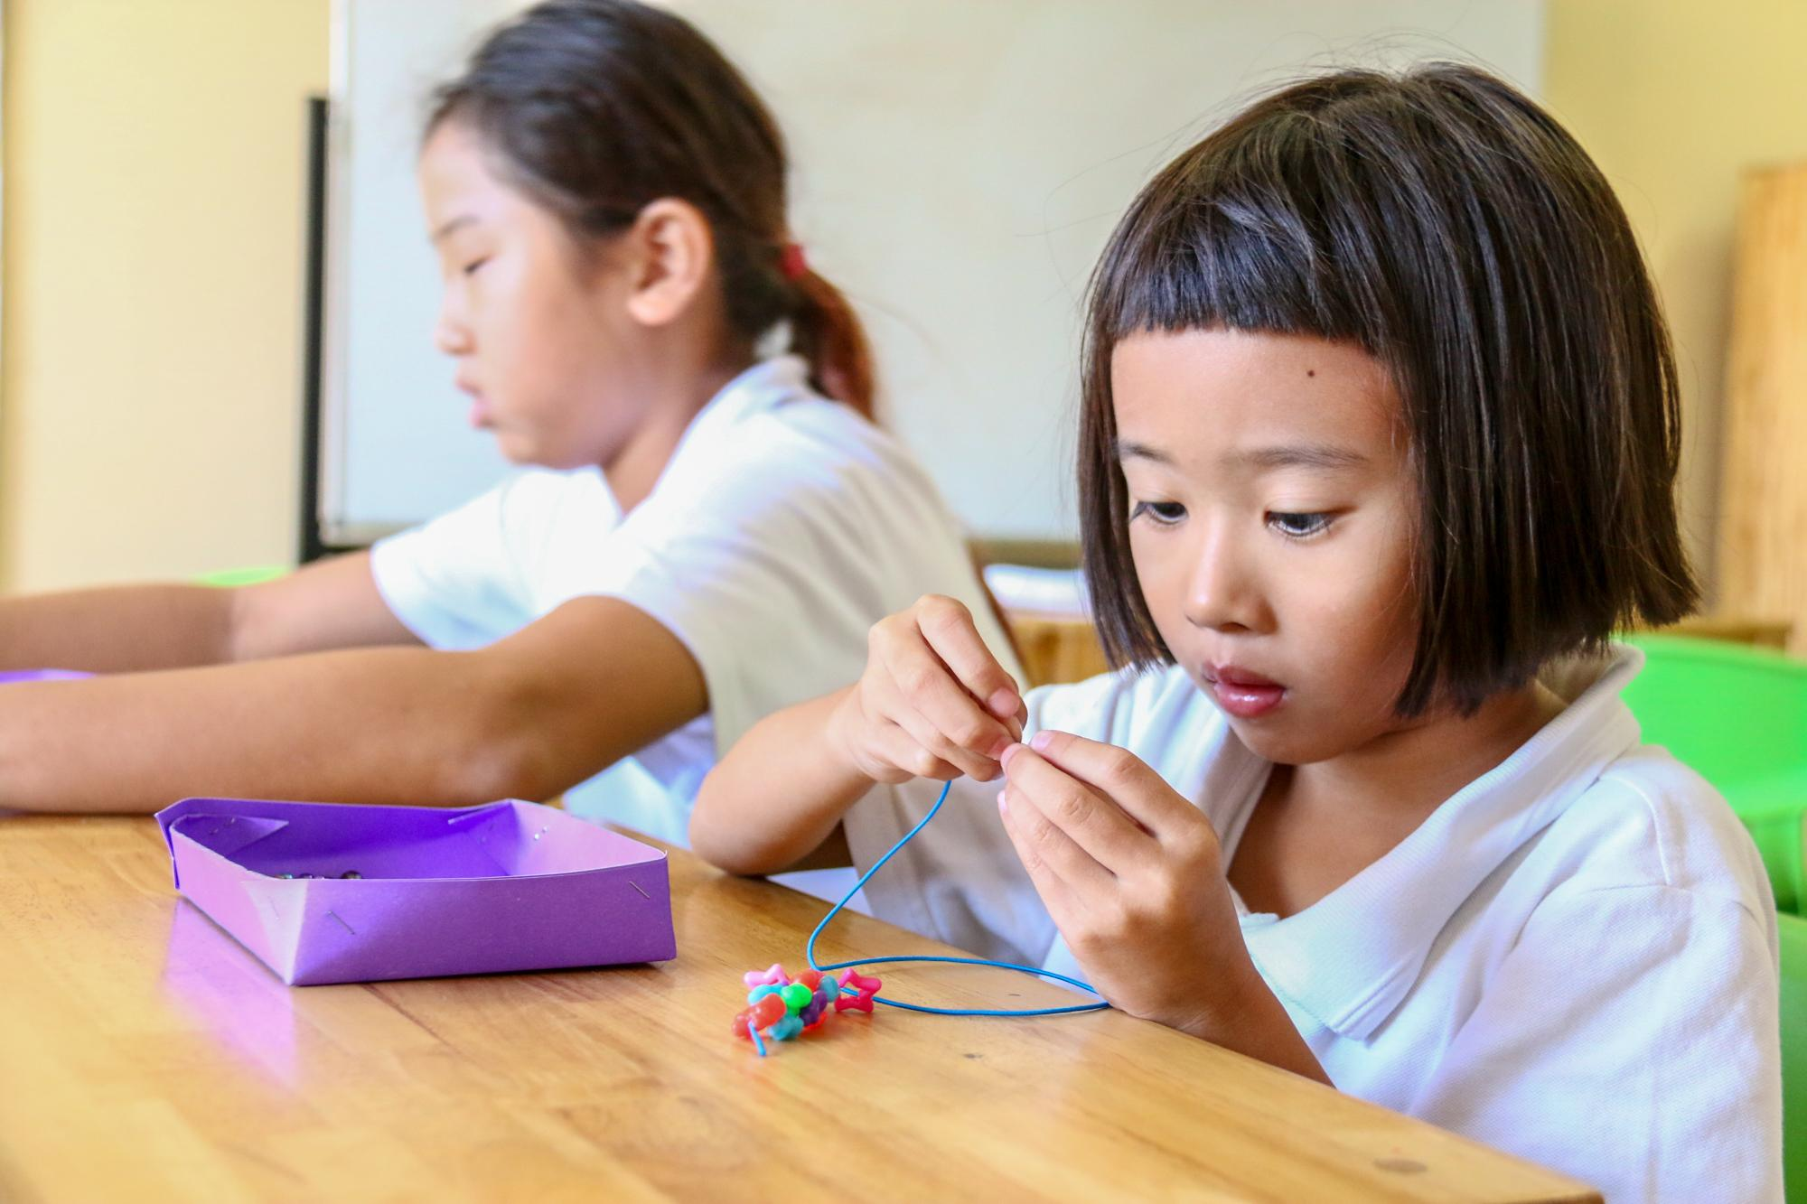
Jewellery Making
Instructor | Ayu Martina
Description | Creations with beads. Let’s make our own jewelry!
Pillar | Arts
Max. Participant | 14
Day & Time | Monday, 3 - 4 PM
Applicable Grade | 1 - 5
Cost | Rp. 50.000,- for materials
Location | Indo B Classroom

Slide 7
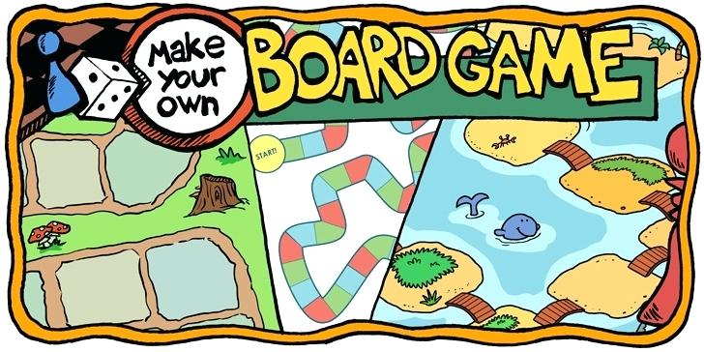
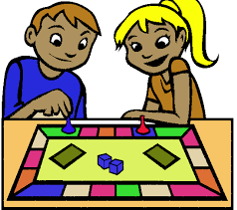
Board Games
Instructor | Nadia Demolder
Description | Playing fun games that support social skills, creativity, language development and problem solving.
Pillar | Co-Curricular
Max. Participant | 12
Day & Time | Monday, 3 - 4PM
Applicable Grade | 3 - 5
Cost | No
Location | Grade 5 Classroom

Slide 8
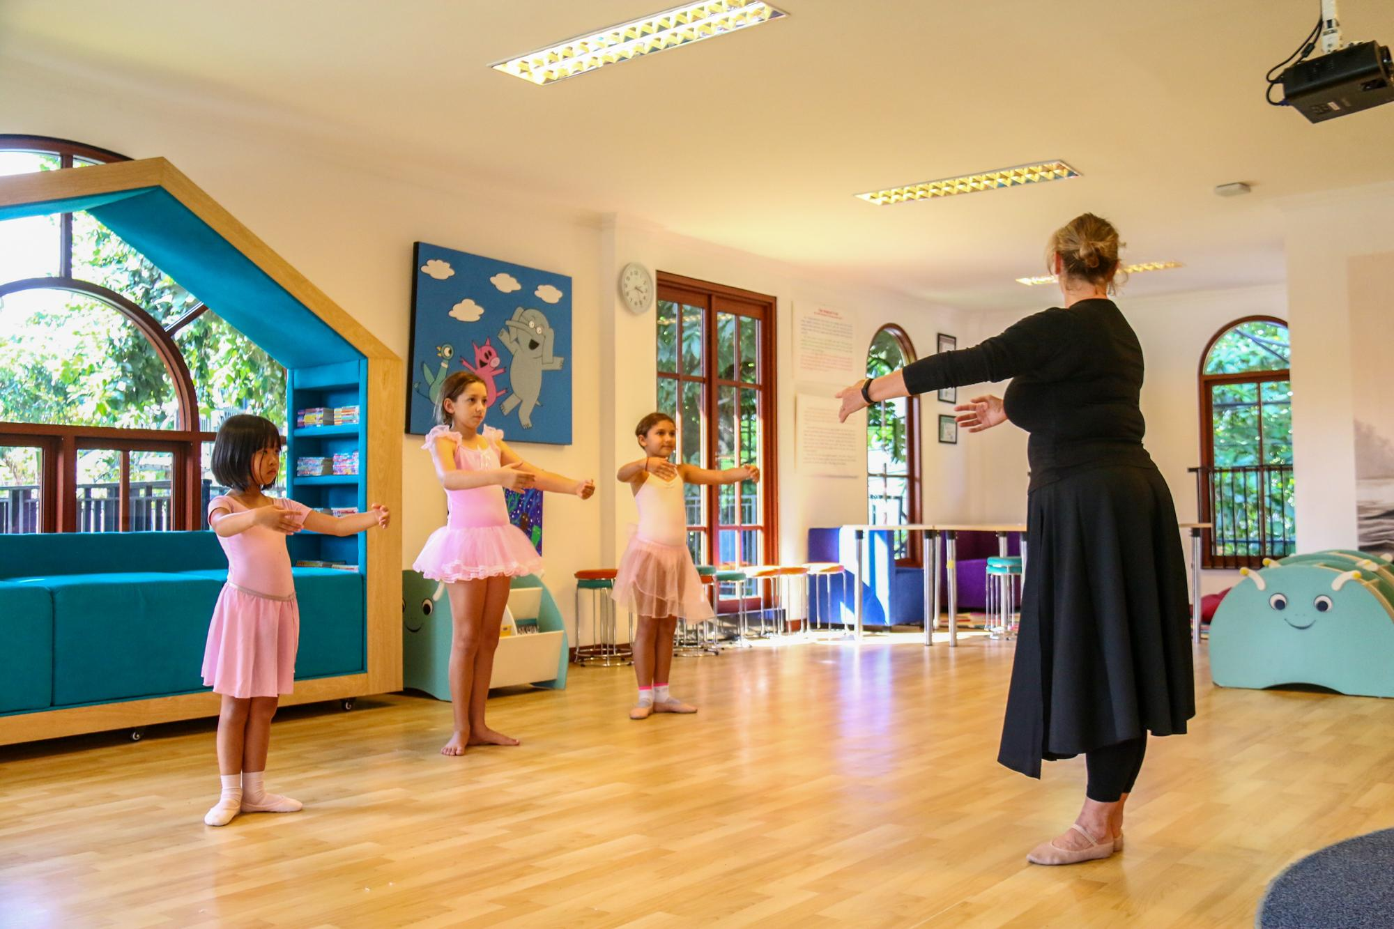
Advanced Ballet
Instructor | Dr. Michelle Shepherd
Description | This class teaches and develops the basics of classical ballet based on the Imperial Society of Teachers of Dancing (ISDT) classical ballet syllabus. The students will learn also have the opportunity to perform in musical recitals and perhaps other performances throughout the school year. Any question please contact Dr. Shepherd.
Pillar | Arts
Max. Participant | 10
Day & Time | Monday, 3 - 4PM
Applicable Grade | 2 - 5
Cost | No
Location | Library Classroom

Slide 9
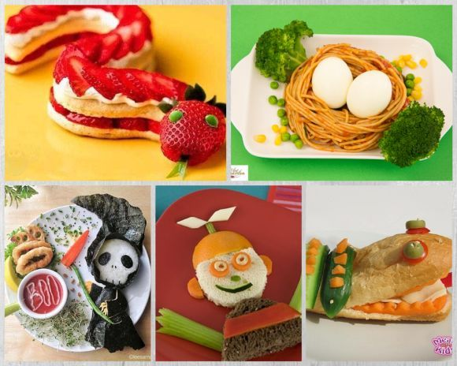
Cooking Club
Instructor | Siska Paramitha
Description | Let’s have fun in the kitchen & play with the recipes so we can make some delicious foods. It’s not only about cooking the meals but also serving it beautifully. We will also try to capture our food and do a little bit of food photography.
Pillar | Arts
Max. Participant | 10
Day & Time | Monday, 3 - 4PM
Applicable Grade | 3 - 5
Cost | Rp. 100.000,- for the ingredients & print photos of the foods
Location | Staff Room Kitchen

Slide 10
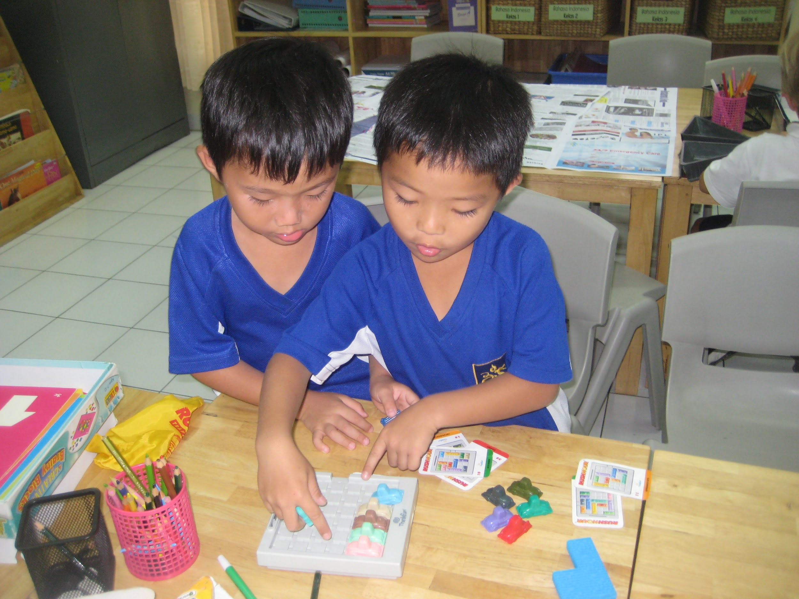
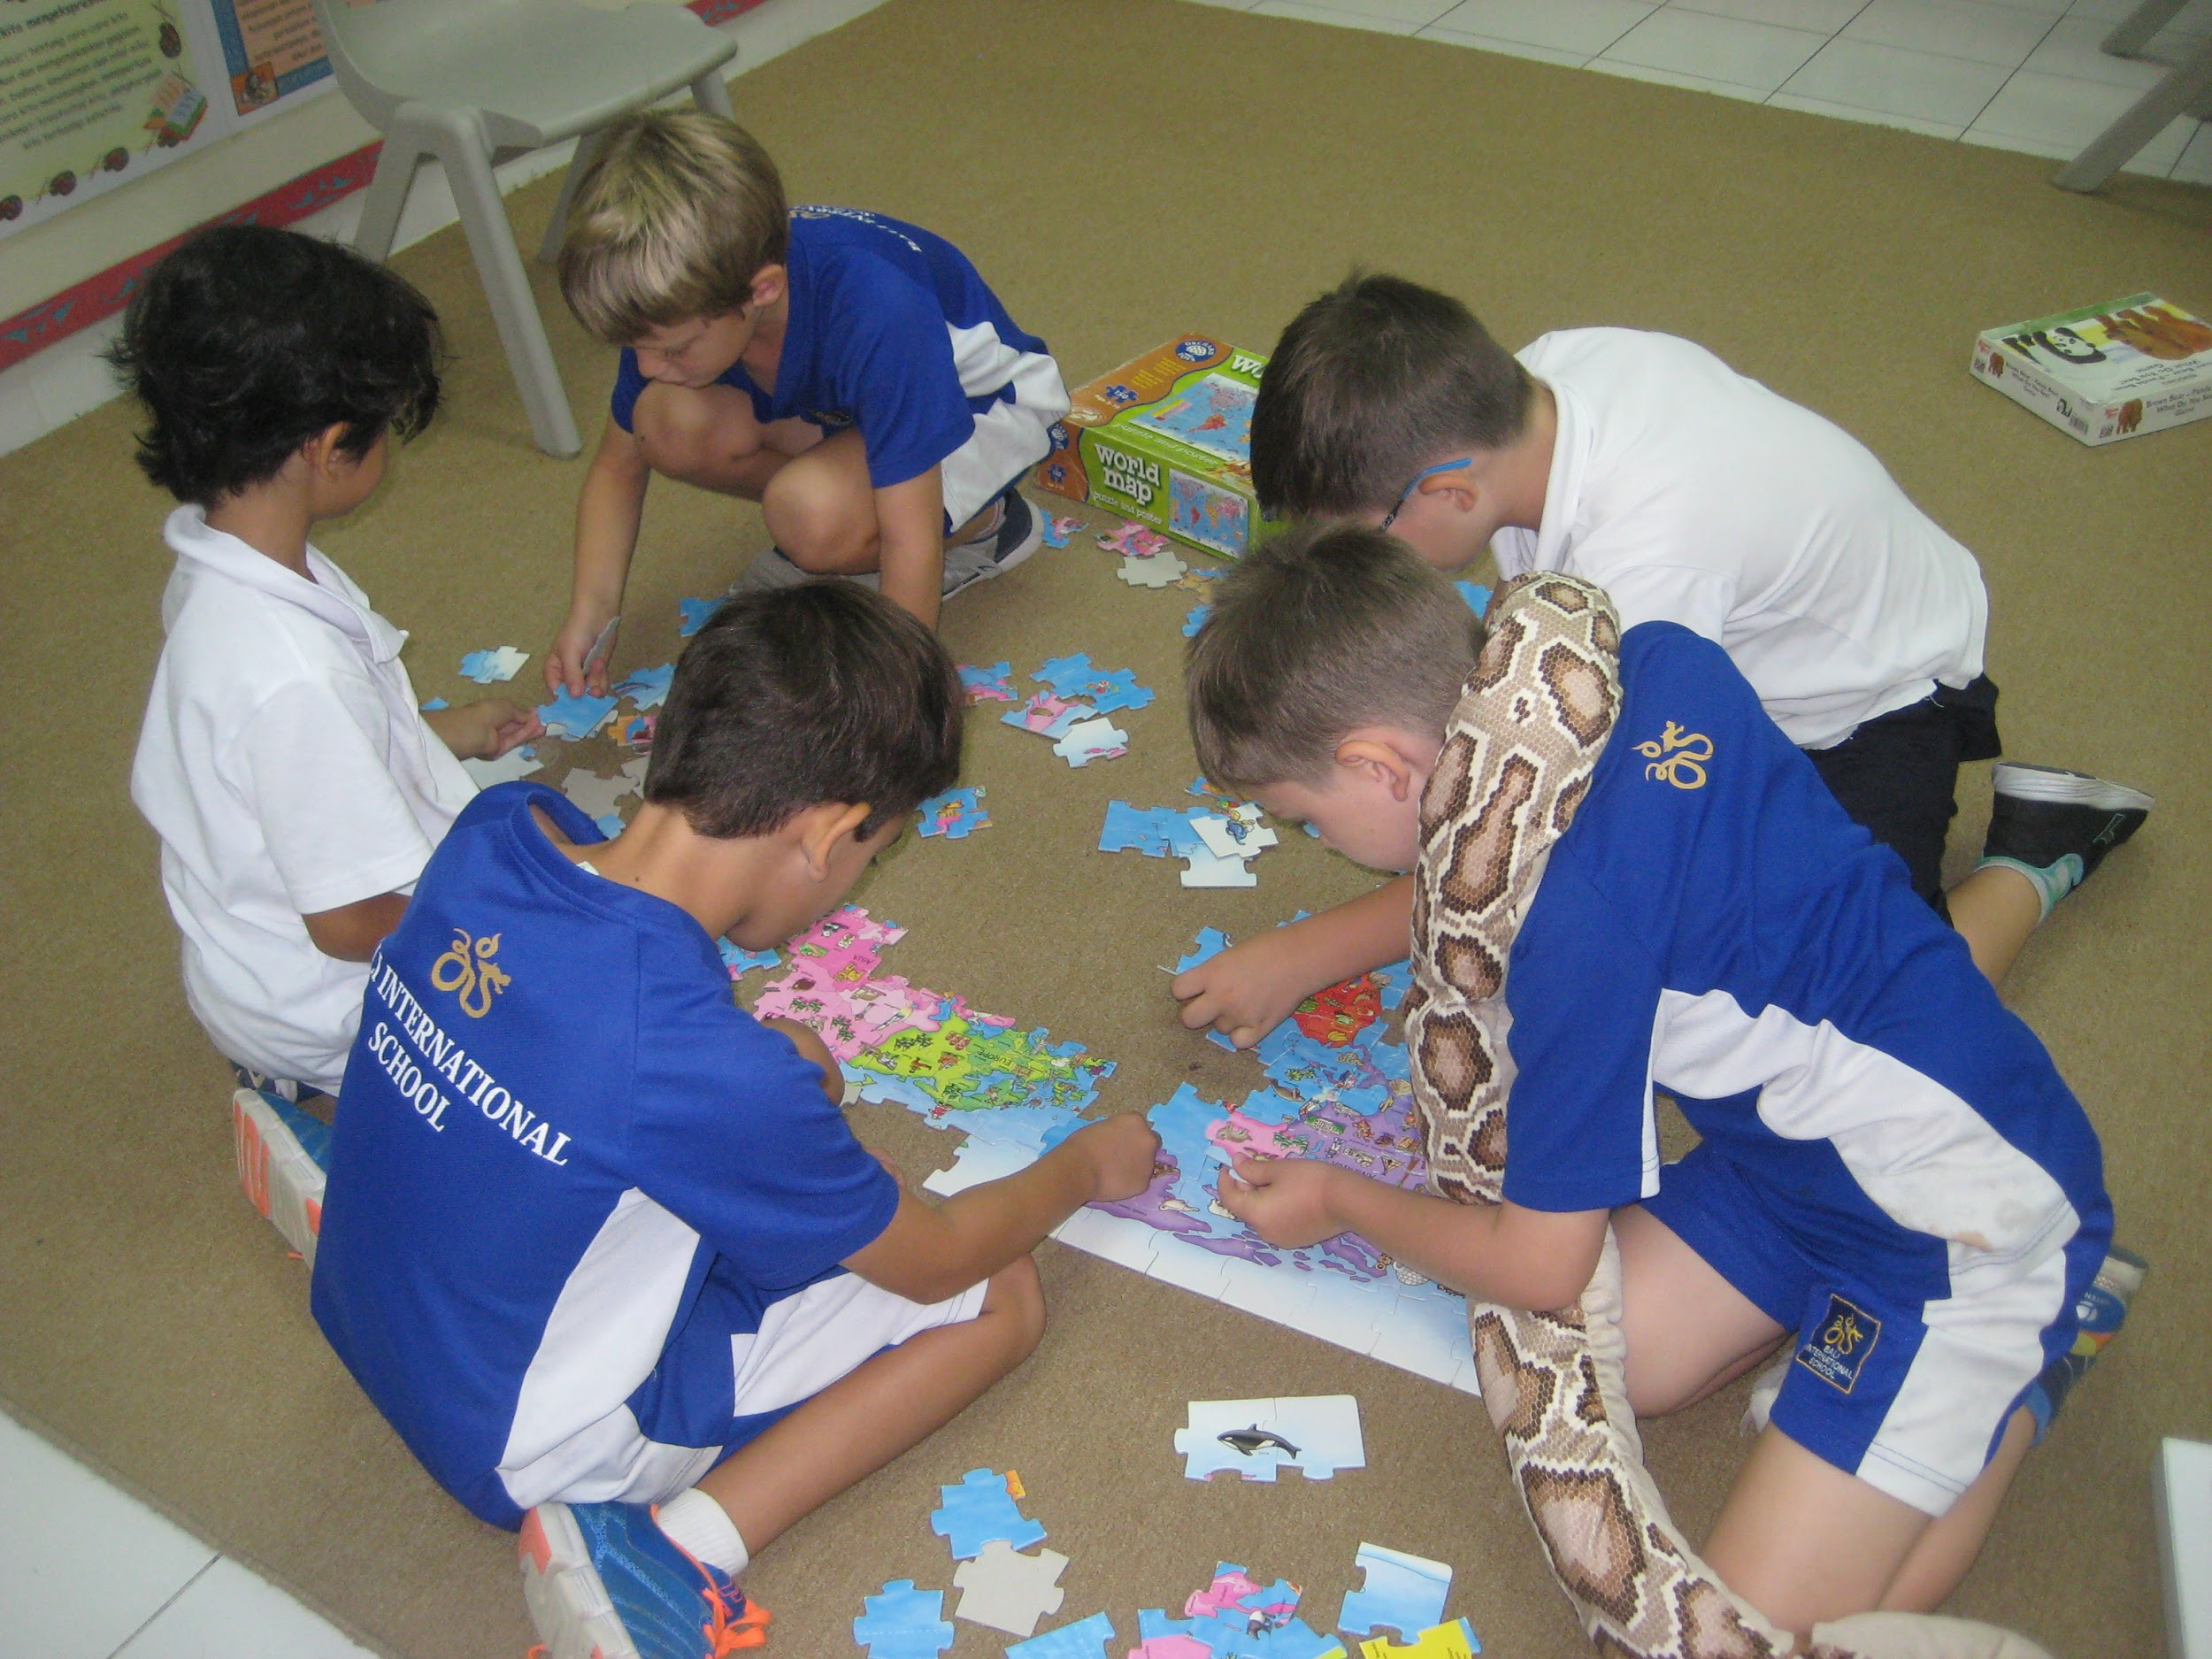
Brain Games
Instructor | Kristina Hutapea
Description | Come work those neurons by playing fun games that will help you think faster and help you remember things. If you’d like to try your hand at firing up your logical instincts, we’ve got the games for you! If you’d rather put some puzzles together, we can accommodate!
Pillar | Recreation
Max. Participant | 15
Day & Time | Monday, 3 - 4PM
Applicable Grade | Kindy - 2
Cost | No
Location | Indo A Classroom

Slide 11
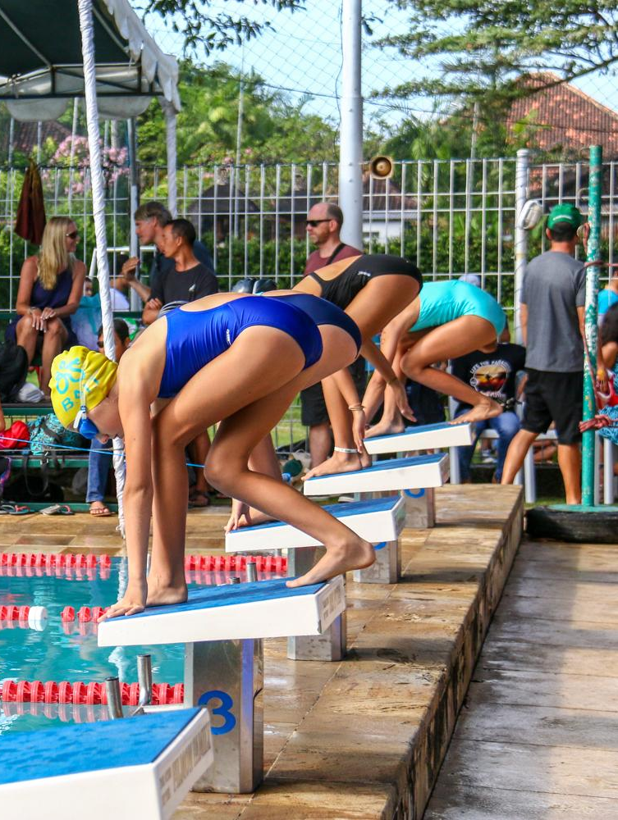
Monday Swimming
Instructor | Jackie Wyncoll & Makiko Wood
Description | Pre season swim training for experienced swimmer only. Focus will be on building strength and stamina
Pillar | Sport
Max. Participant | 20
Day & Time | Monday, 3 - 4PM
Applicable Grade | 3 - 12
Cost | No
Location | BIS Pool

Slide 12
Singing Club
Instructor | Istiqomah Irina Proboningtyas
Description | If you love singing, sign up! Everybody in this club will have a chance to upgrade their singing skills.
Pillar | Arts
Max. Participant | 20
Day & Time | Wednesday, 3 - 4PM
Applicable Grade | 3 - 5
Cost | No
Location | Primary Music Room

Slide 13
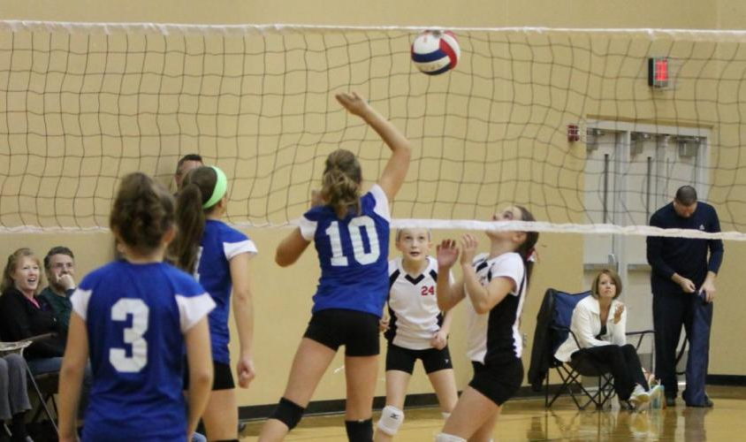
BSSA Volleyball
Instructor | Hamish Sutherland, Sam Watson, Gary Brown, Ayu Rukmiantari
Description | BSSA Volleyball comp against other schools. Most games at home but some games at Dyatmika School.
Pillar | Sport
Max. Participant | Open
Day & Time | Wednesday, 3 - 4PM
Applicable Grade | 9-10 / 11-12/ 13-15 years old
Cost | No
Location | Big Field

Slide 14
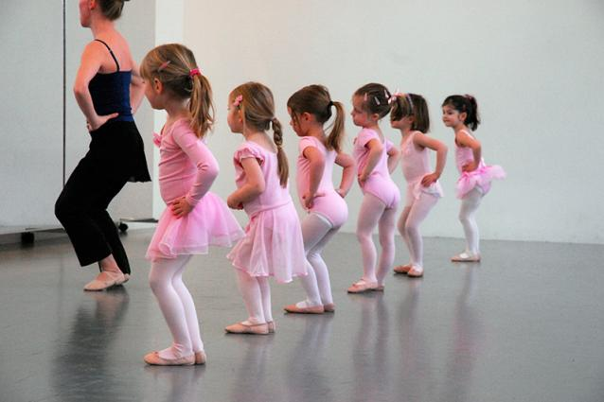
Beginners Ballet
Instructor | Michelle Shepherd
Description | This class is aimed at younger students and develops musicality, movement and the basics of classical ballet based on the Imperial Society of Teachers of Dancing (ISDT) classical ballet syllabus. Students will learn ballet steps and develop balance, creativity and confidence. Any questions please contact Dr. Shepherd
Pillar | Arts
Max. Participant | 10
Day & Time | Wednesday, 3 - 4PM
Applicable Grade | Kindy - 1
Cost | No
Location | MPR

Slide 15
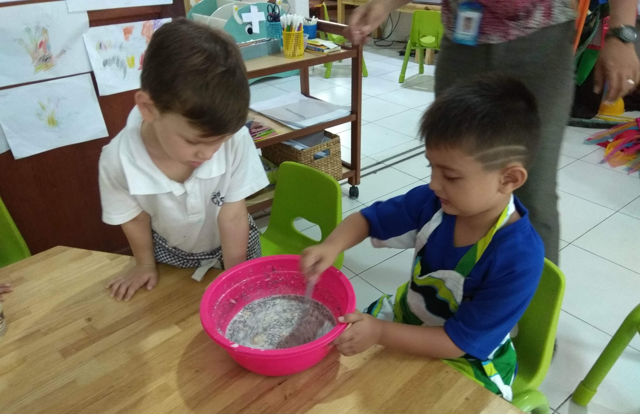
Mini Cooking
Instructor | Paramitha Dewi & Dayu Dian
Description | Let’s cook some yummy dishes & be creative like grown ups in the kitchen and create our own recipe books.
Pillar | Arts
Max. Participant | 15
Day & Time | Wednesday, 3 - 4PM
Applicable Grade | Kindy - 2
Cost | Rp 100.000,- for the ingredients
Location | Staff Room Kitchen

Slide 16
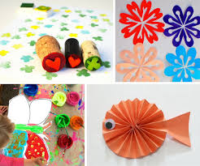
Art & Craft
Instructor | Made Artini & Nyoman Winarti
Description | Let’s do art & craft using different materials.
Pillar | Arts
Max. Participant | 15
Day & Time | Wednesday, 3 - 4PM
Applicable Grade | Kindy - 3
Cost | Rp. 50.000,- for the materials
Location | Staff Room Kitchen

Slide 17
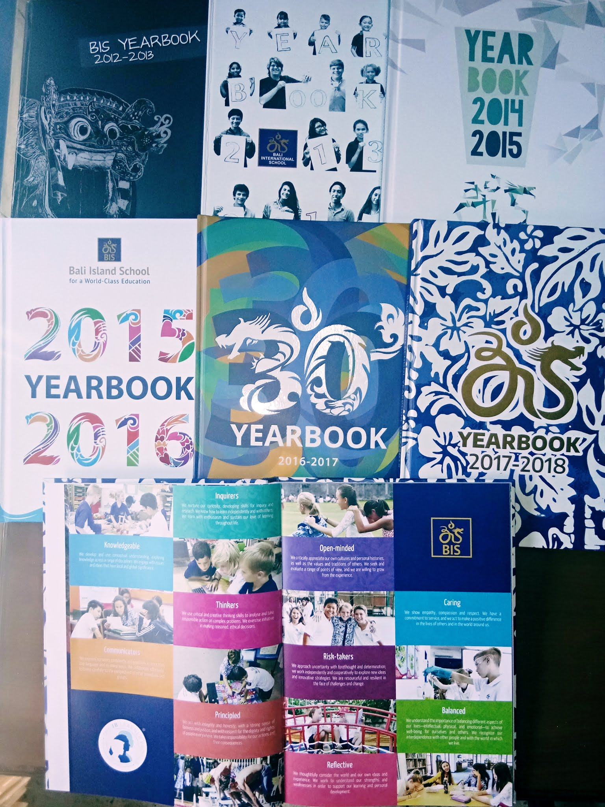
Lunch Yearbook
Instructor | Heather McNaughton
Description | Help to plan the layout and page content for this year’s Yearbook.
Pillar | Arts
Max. Participant | 14
Day & Time | Thursday, 12.25 - 1.10PM
Applicable Grade | 4 - 12
Cost | No
Location | Grade 3 Classroom

Slide 18
Lunch Dodgeball
Instructor | Craig Eldred
Description | We’ll play some fun games such as dodgeball, dodgeball variations, rob the nest and stuck in the mud.
Pillar | Sports
Max. Participant | Open
Day & Time | Thursday, 12.40 - 1.10PM
Applicable Grade | 3 - 5
Cost | No
Location | Big Field

Slide 19
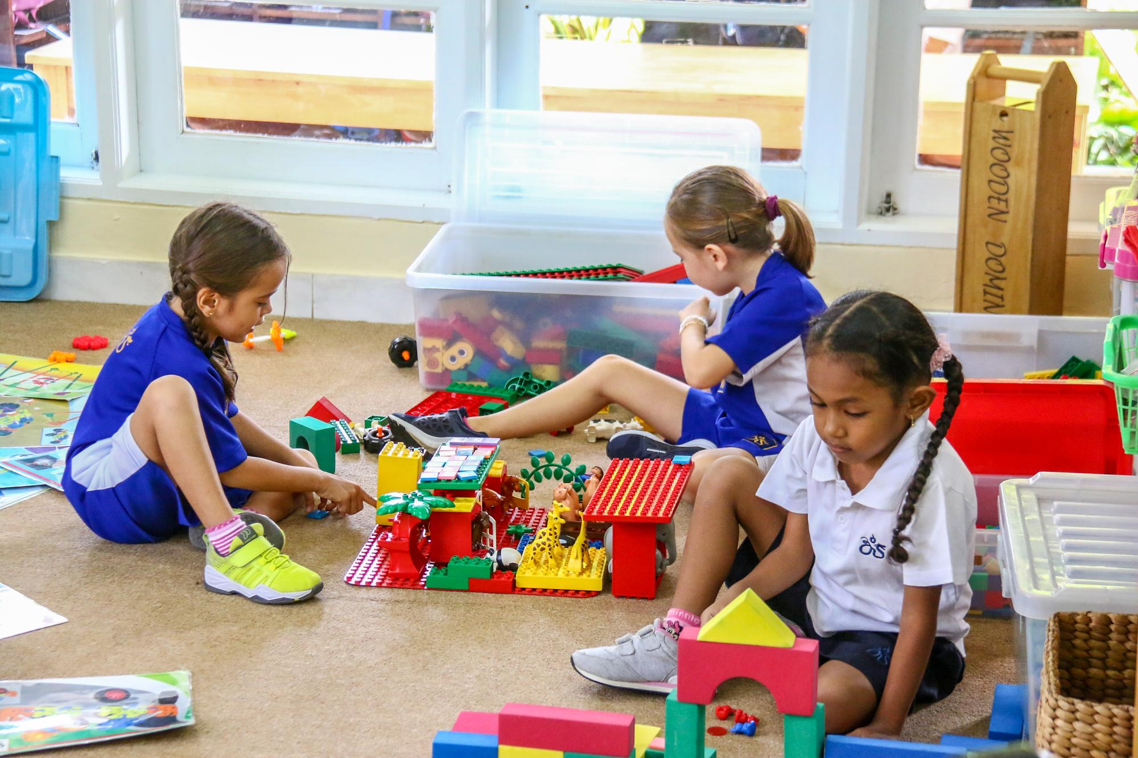
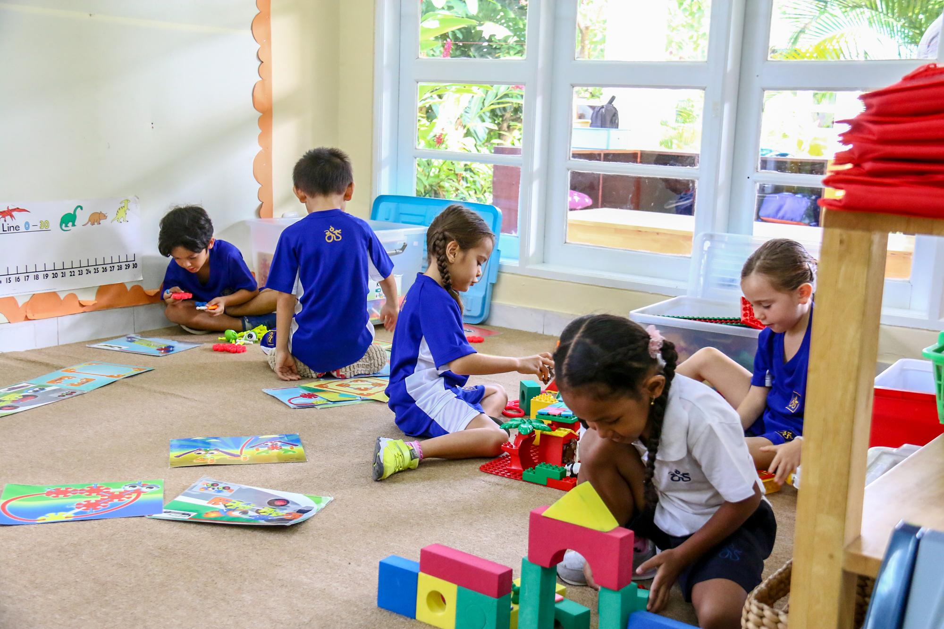
Lego & Building Club
Instructor | Denise Mulhaire
Description | Build with lego, wooden blocks, train tracks, 3D shapes, marble run & more!
Pillar | Recreation
Max. Participant | 15
Day & Time | Thursday, 3 - 4 PM
Applicable Grade | Kindy - 3
Cost | No
Location | Grade 1 Classroom

Slide 20
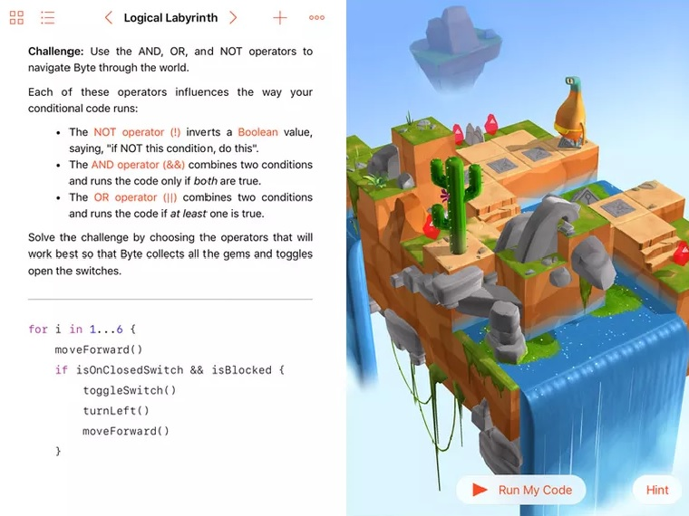
Computer Coding
Instructor | Craig Eldred
Description | Introduction to computer coding using a number of mostly free apps such as Swift and Hopscotch. Students will be required to bring own iPads or other tablets. We will also work with Scratch on the school laptops. A list of the apps being used will be shared with parents and students before the activities commence.
Pillar | Recreation
Max. Participant | 16
Day & Time | Thursday, 3 - 4 PM
Applicable Grade | 3 - 5
Cost | No
Location | Library Classroom

Slide 21
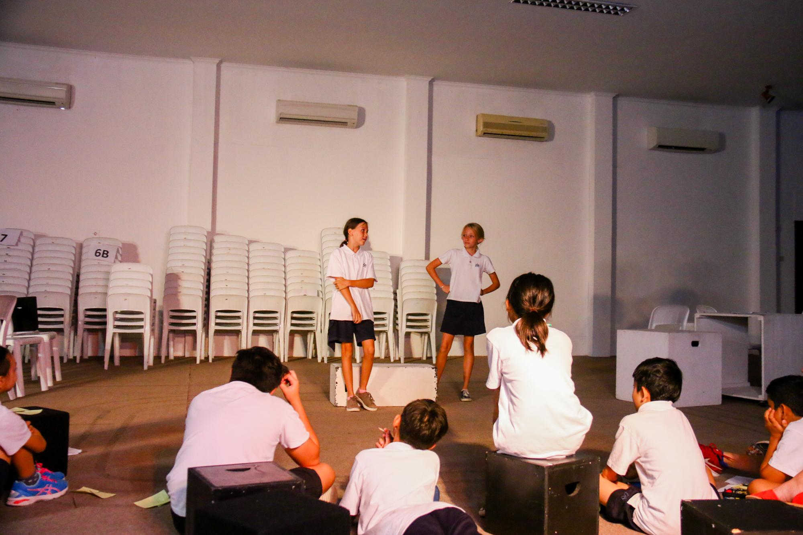
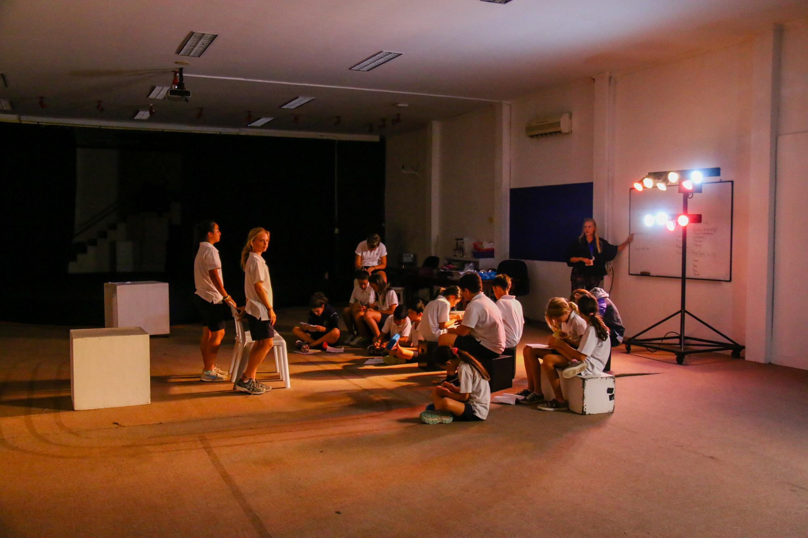
Primary Drama
Instructor | Michelle Shepherd
Description | Primary drama club is a fun activity which promotes creativity, confidence and team building. It leads to development of acting, communication and collaboration skills as we build a play which will be performed at the end of term two (December). This activity is continuing from term 1 and is not accepting any additional students.
Pillar | Arts
Max. Participant | 24
Day & Time | Thursday, 3 - 4 PM
Applicable Grade | 3 - 5
Cost | No
Location | MPR

Slide 22
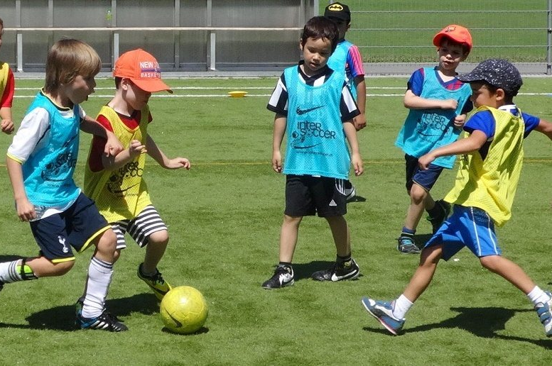
Mini Football
Instructor | Pak Nyoman
Description | Junior Football for Kindy to 8 year olds, they will not be playing against other schools. It is just our kids training and playing together
Pillar | Sport
Max. Participant | Open
Day & Time | Thursday, 3 - 4 PM
Applicable Grade | Kindy - 2
Cost | No
Location | Big Field

Slide 23
Thursday Swimming
Instructor | Jackie Wyncoll & Makiko Wood
Description | Pre season swim training for experienced swimmer only, Focus will be on building strength and stamina
Pillar | Sport
Max. Participant | 20
Day & Time | Thursday, 3 - 4PM
Applicable Grade | 3 - 12
Cost | No
Location | BIS Pool

Slide 24
Math Games
Instructor | Melanie Knudson
Description | Come and learn to play a variety of games using different math tools. Woo hoo! GOOOO Math.
Pillar | Co-curricular
Max. Participant | 15
Day & Time | Thursday, 3 - 4PM
Applicable Grade | 1 - 3
Cost | No
Location | Grade 2 Classroom

Slide 25
Design & Technology
Instructor | Kristen Turner & Made Artini
Description | Following the design cycle to create. Working with tools and technology to plan, design and create something in response to a provocation (textiles, wood...)
Pillar | Arts
Max. Participant | 20
Day & Time | Monday, 3 - 4PM
Applicable Grade | 1 - 3
Cost | Rp. 50.000,- for material
Location | Grade 4 Classroom

Slide 26
Lunch Dodgeball
Instructor | Craig Eldred
Description | We’ll play some fun games such as dodgeball, dodgeball variations, rob the nest and stuck in the mud.
Pillar | Sports
Max. Participant | Open
Day & Time | Friday, 12.40 - 1.10PM
Applicable Grade | K - 2
Cost | No
Location | Primary Field

Slide 27
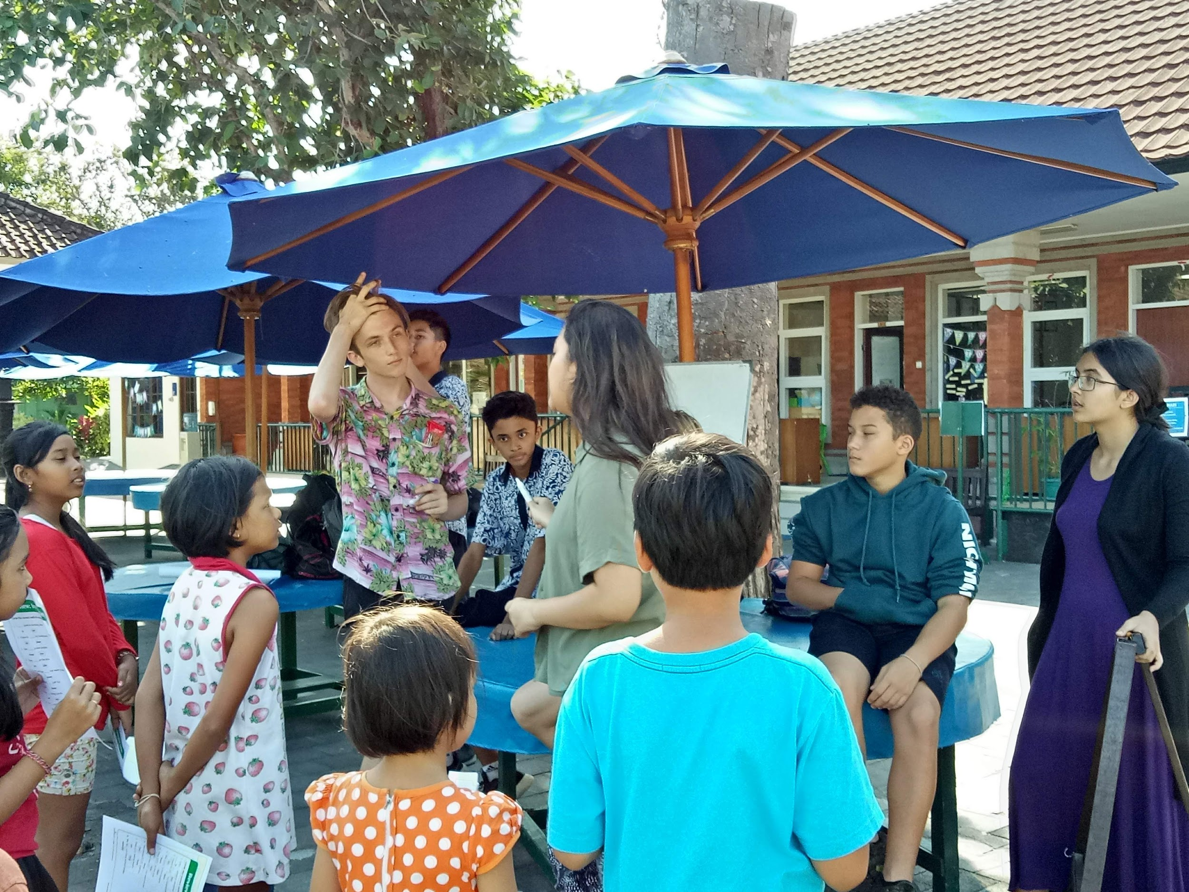
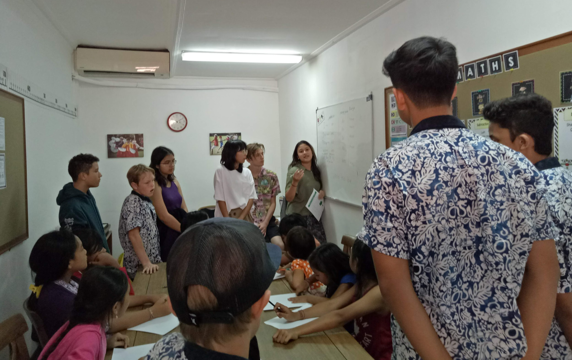
Taman Bacaan Reading Buddies
Instructor | Ketut Radnyanawati & Yunita Reni
Description | Come share your skills and compassion with the local community from the Taman Bacaan group through a reading buddies activity! We will be engaging and supporting the local kids by reading & storytelling from books to improve their English competence..
Pillar | Service
Max. Participant | 14
Day & Time | Friday, 3 - 4PM
Applicable Grade | 3 - 12
Cost | No
Location | Taman Bacaan Area

Slide 28
Secondary
After School Activities
TERM 2

Slide 29
BSSA Volleyball
Instructor | Mr. Hamish Sutherland, Mr. Sam Watson, Ibu Ayu Rukmiantari
Description | BSSA volleyball competition against BSSA schools. Most games at home but some games at Dyatmika
Pillar | Sport
Max. Participant | Open
Day & Time | Wednesday after school and lunchtime practises.
Applicable Grade | 9-10/11-12/13-15 Years Old
Cost | n/a
Location | BIS and other BSSA schools

Slide 30
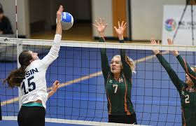
Girls Senior Volleyball
Instructor | Mr. Wood
Description | Girls Senior Volleyball
Pillar | Sport
Max. Participant | 20ish participants
Day & Time | Monday & Wednesday From 3-4 pm
Applicable Grade | Secondary (Grade from G6 can join, but must have existing skills to actively contribute to the senior team)
Cost | n/a
Location | Covered sport area

Slide 31
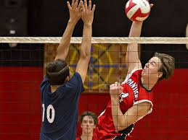
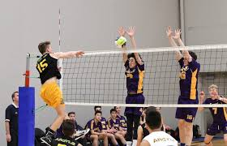
Boys Senior Volleyball
Instructor | Mr. Wilson
Description | We will be training teams for the December senior volleyball tournament.
Pillar | Sport
Max. Participant | 15-20 participants (12 + years old)
Day & Time | Monday & Thursday from 3-4 pm
Applicable Grade | Secondary (Grade 6 and up, however the senior boys who are no longer eligible for BSSA on wednesday will have priority )
Cost | Possible Jerseys
Location | Covered sport area

Slide 32
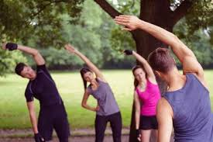
Morning Aerobics
Instructor | Mr. Watson
Description | Let’s move your body, every Monday & Wednesday morning
Pillar | Sport
Max. Participant | 40
Day & Time | Monday & Wednesday from 7:30-7:45 am
Applicable Grade | Open to all
Cost | n/a
Location | MPR

Slide 33
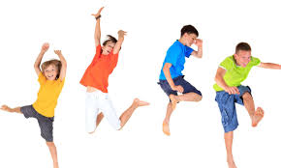
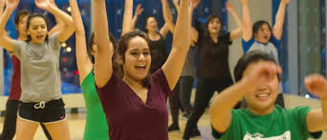
Fitness for Life
Instructor | Mrs. Erickson
Description | Want to be more fit? Want to learn some great workouts that need very little equipment and yet still get you moving? Join me after school and let’s get fit for life! All you need are tennis shoes and water bottle.
Pillar | Sport
Max. Participant | Open (11+ years old)
Day & Time | Thursday from 3-4 pm
Applicable Grade | Grade 6 and up (Teachers are welcome to join)
Cost | n/a
Location | TBD (probably Room 3)

Slide 34
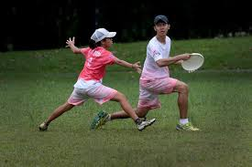
The Ultimate Frisbee
Instructor | Ms. Mclay
Description | Join in and play the fastest game in the world. No experience necessary. Learn the skills to throw and catch a disc and the strategy of the game. Bring just yourself, good running shoes and enthusiasm. It’s a fast paced sport so its perfect for fitness buffs.
Pillar | Sport
Max. Participant | 25
Day & Time | Monday from 3-4 pm
Applicable Grade | Grade 6-12
Cost | n/a
Location | Big Field

Slide 35
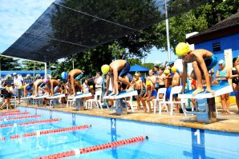
Pre Season Swimming
Instructor | Mrs. Wyncoll & Mrs. Wood
Description | Pre-season swimming training for experienced swimmers only. Focus will be on building strength and stamina.
Pillar | Sport
Max. Participant | 24
Day & Time | Monday and Thursday from 3-4 pm
Applicable Grade | Grade 3-12
Cost | n/a
Location | Swimming Pool

Slide 36
MYP Math Support
Instructor | Mr. Ferris
Description | Support for students to better understand the current concepts being learned in MYP 1,2 & 3 units
Pillar | Curriculum
Max. Participant | 20
Day & Time | Monday from 3-4 pm
Applicable Grade | Grade 6-8
Cost | n/a
Location | Room 6

Slide 37
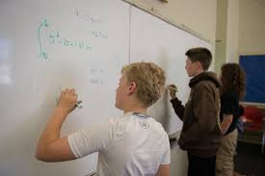
Math Office Hour
Instructor | Mr. Gokalp
Description | Open to any students who need help in Maths.
Pillar | Curriculum
Max. Participant | 20
Day & Time | Wednesday from 2:45 - 3:45 pm
Applicable Grade | Grade 6-12
Cost | n/a
Location | Room 6

Slide 38
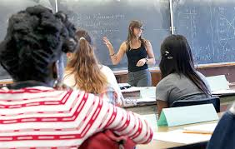
Math Support - any levels
Instructor | Mrs. Wood & Mr. Collins
Description | Support will be offered to students to better understand the current concepts being learned in any level
Pillar | Curriculum
Max. Participant | 20
Day & Time | Wednesday from 3-4 pm (Grade 6-12) Thursday from 3-4 pm (Grade 6-9)
Applicable Grade | All secondary
Cost | n/a
Location | Wednesday (Room 9) Thursday (Room 1)

Slide 39
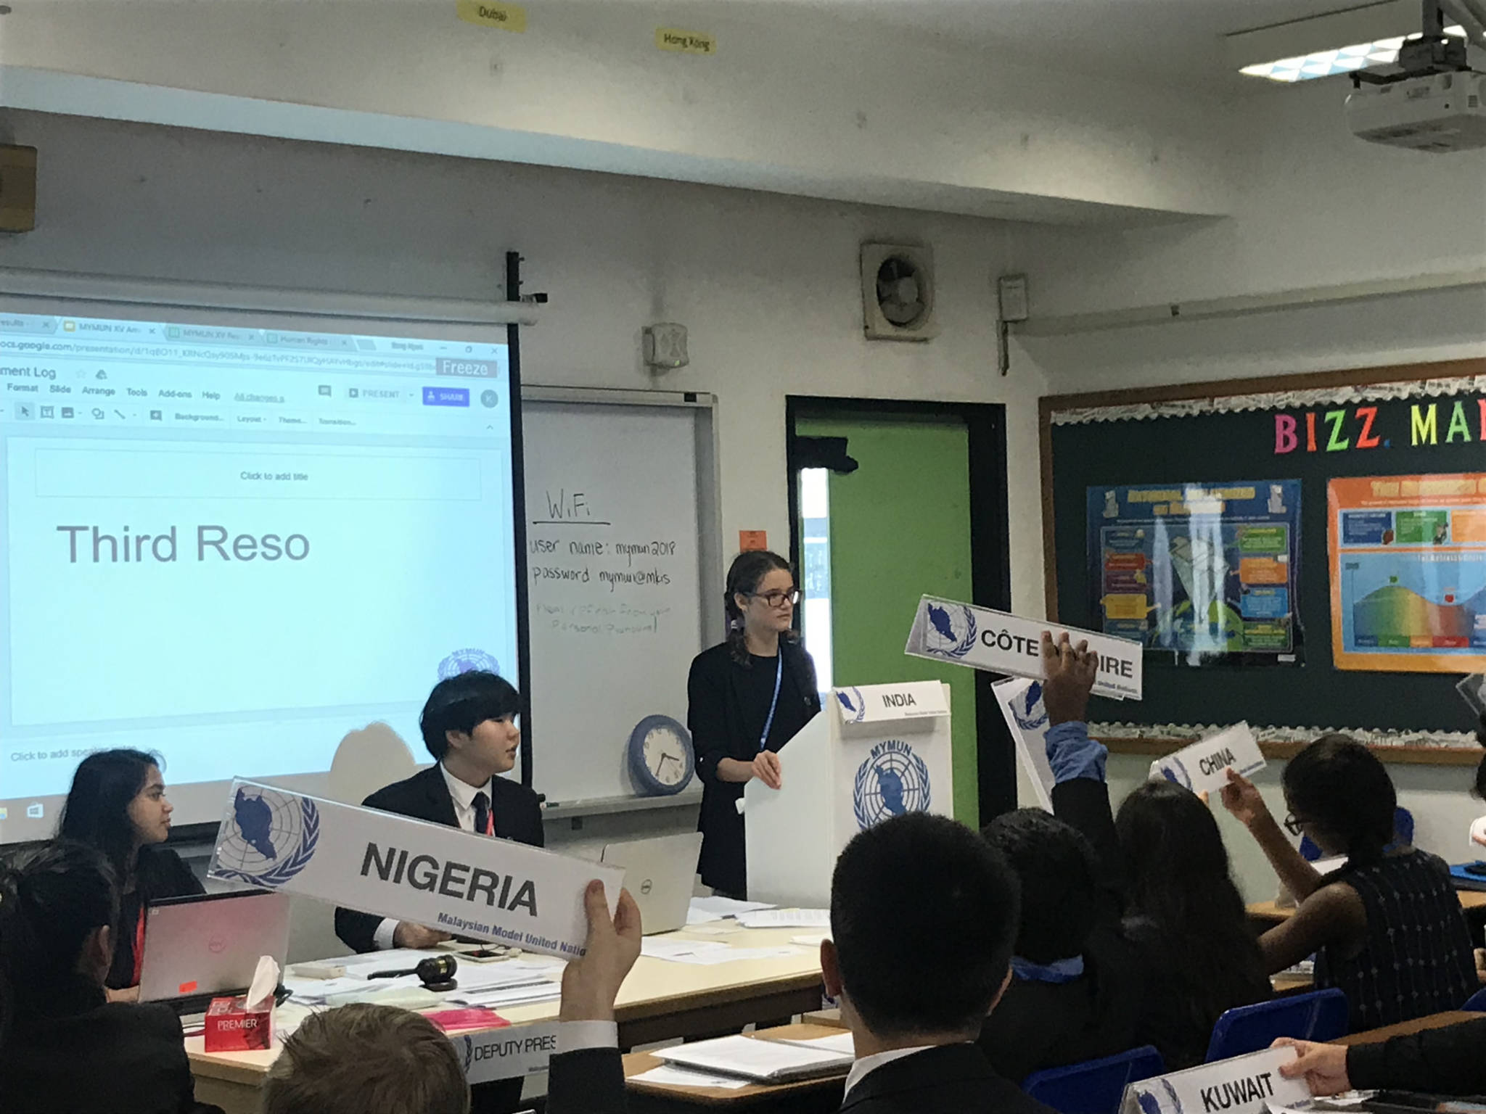
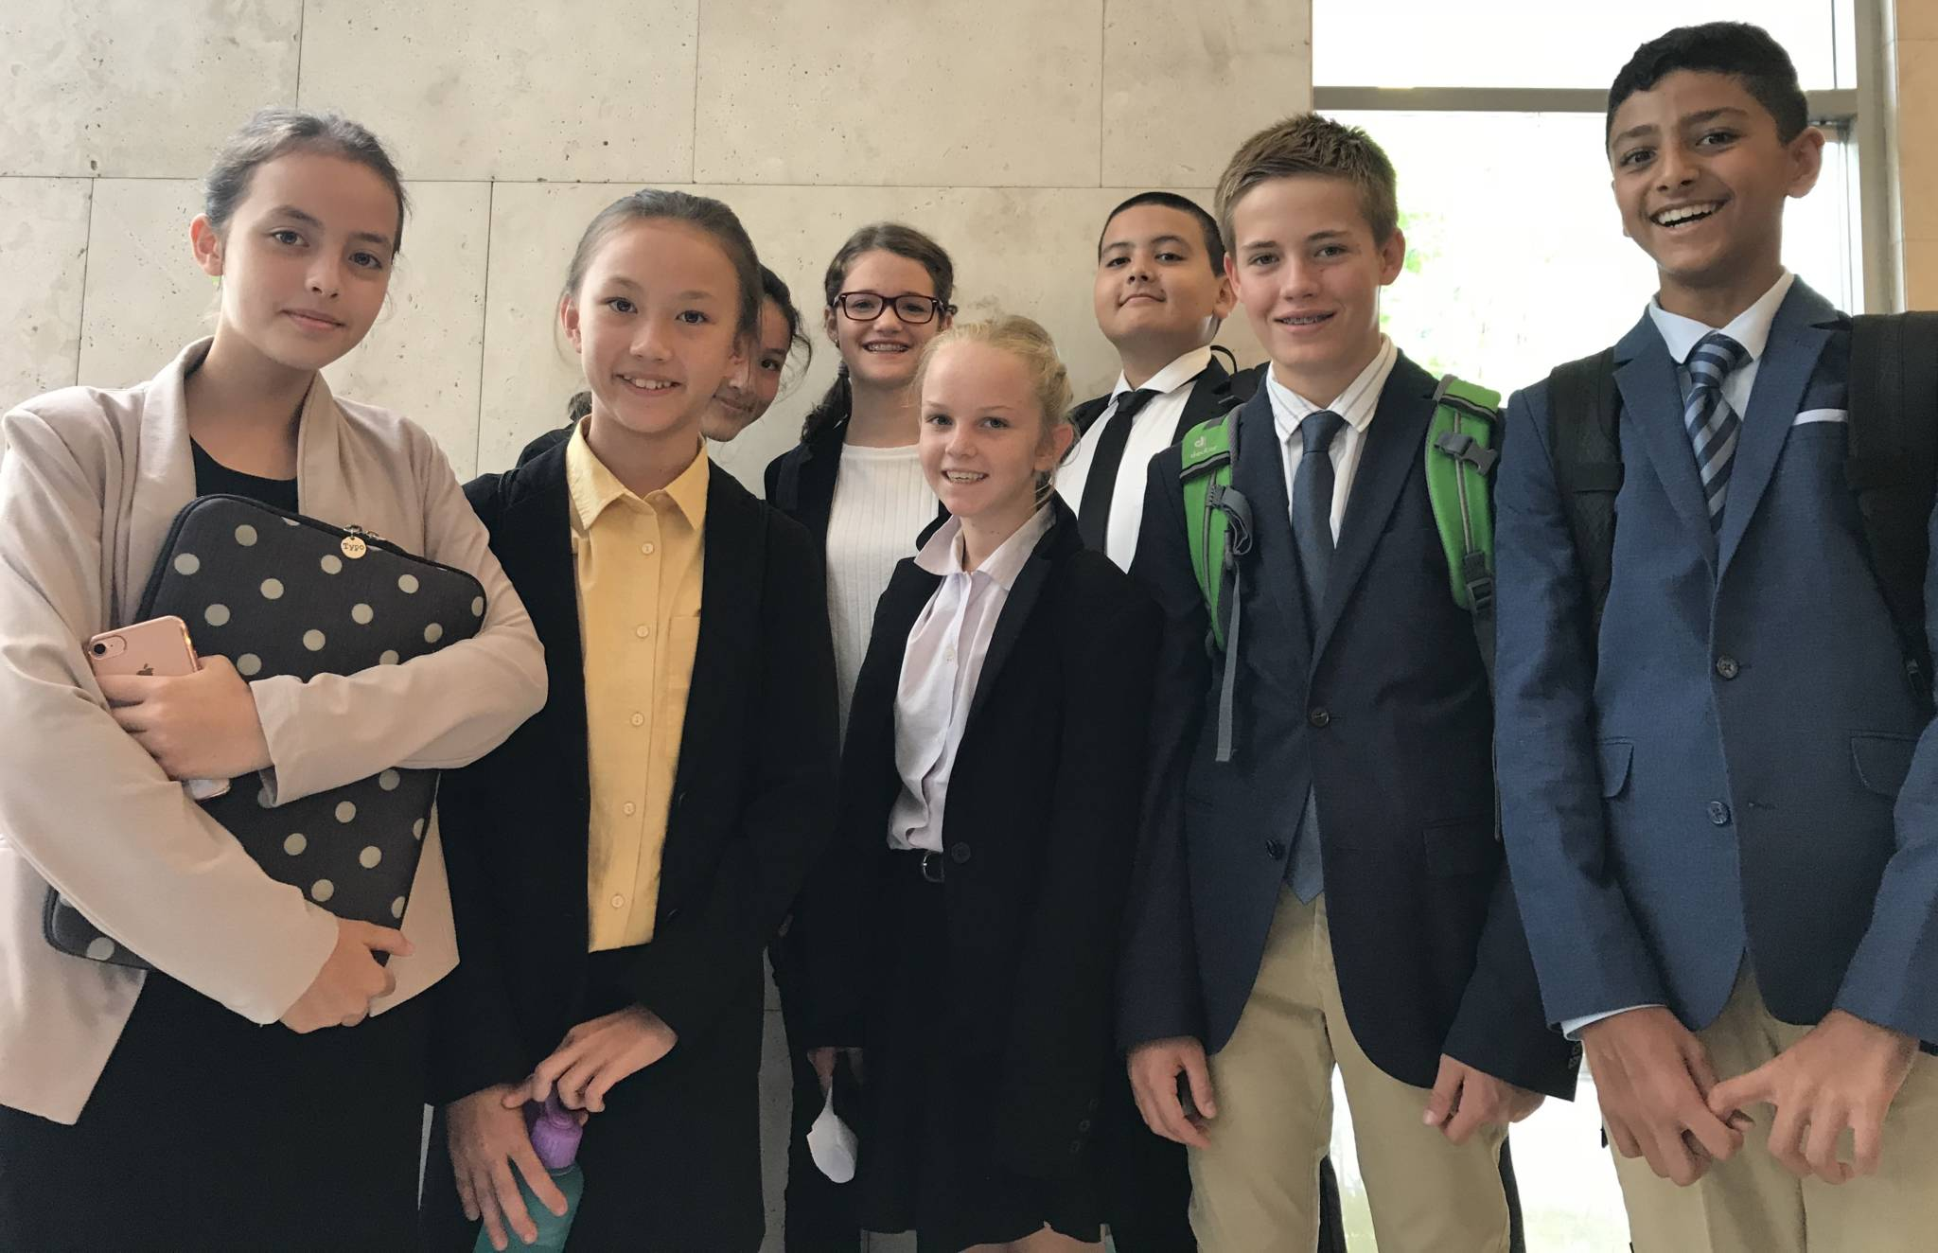
Model United Nations (MUN)
Instructor | Mr. Marshall & Mr. Knudson
Description | Mock UN stuff
Pillar | Co-Curricular
Max. Participant | NOT OPEN to new member. Currently participants will stick with MUN Term 2 because of Bali MUN in November.
Day & Time | Monday and Wednesday at lunch time
Applicable Grade | Grade 6 + (12+ years old)
Cost | TBD but yes
Location | Room 6

Slide 40
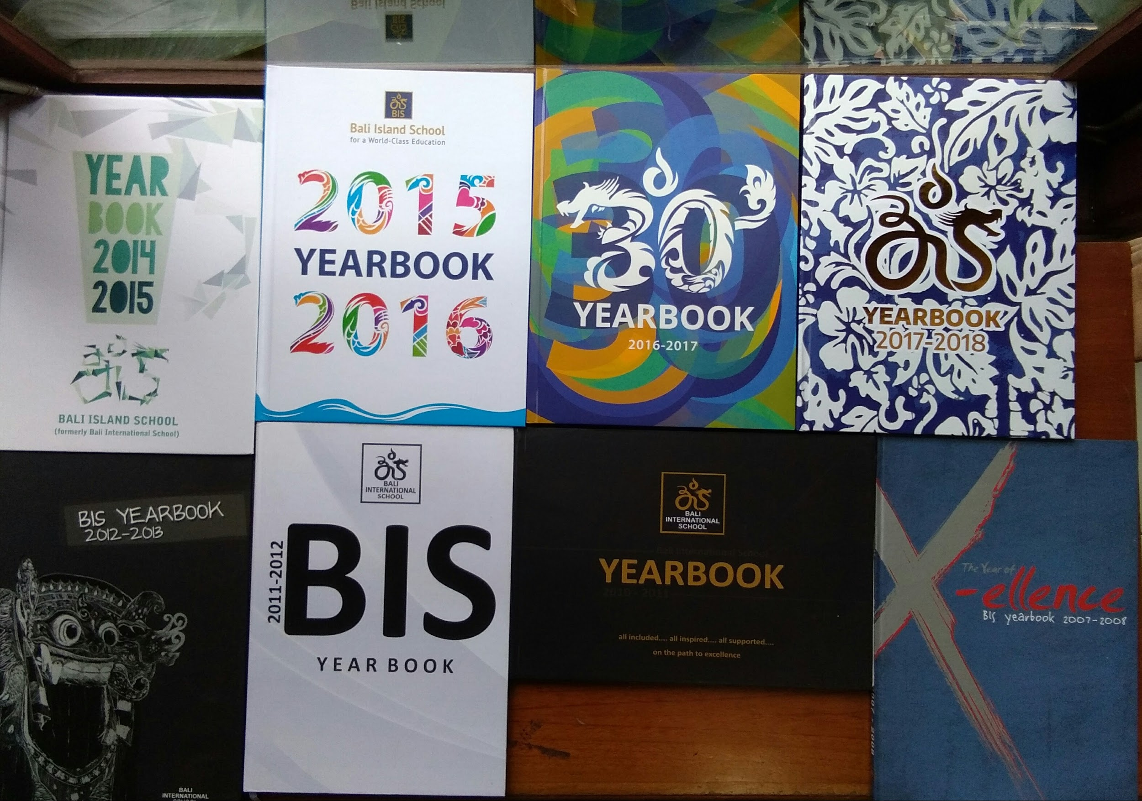
Yearbook
Instructor | Ms. Heather McNaughton
Description | Help to plan the layout and page content for this year’s Yearbook.
Pillar | Co-curricular
Max. Participant | 14 (7 Primary and 7 Secondary)
Day & Time | Thursday from 12:25 - 1:10 pm
Applicable Grade | Grade 4-12
Cost | n/a
Location | Grade 3 Classroom

Slide 41
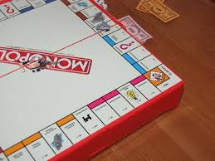
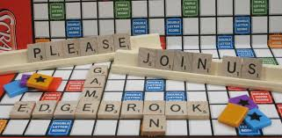
Board Game Club
Instructor | Ms. Taylor & Ibu Sri Mahendrani
Description | Come along and play a range of board games with your friends.
Pillar | Co-curricular
Max. Participant | 25
Day & Time | Monday from 3-4 pm
Applicable Grade | Grade 6-12
Cost | n/a
Location | Room 4

Slide 42
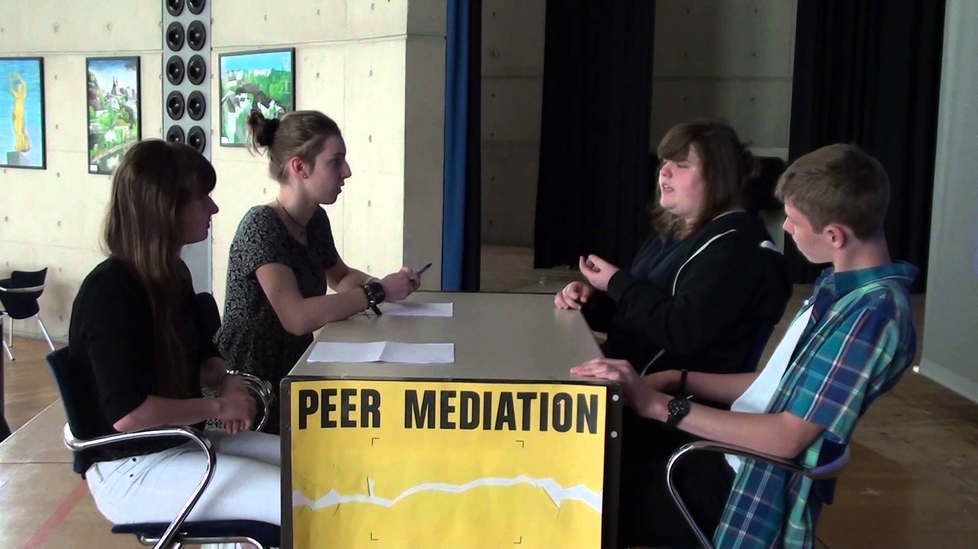
Peer Mediation
Instructor | Ms. Rachael Gerbic
Description | Students in the training will learn a 6-step conflict resolution model and will become a trained peer mediators, able to assist others in resolving their conflicts and finding win-win solutions. Mediation is a life skill utilized in schools, business, courts and by ambassadors and governments. It helps young people develop strong communication skills, build self esteem as balanced leaders within their community, and create a culture of peace on their school campuses. To undergo this training, students must commit to attend all 14 training sessions in Term 2 & 3. Ideally there will be at least two students per grade level in the secondary school and preferably a mix of boys and girls from each grade. Teachers may also join the training. The more trained mediators at school, the better! We will meet once a week after school throughout Term 2 and 3. Please sign up if you think this opportunity is for you.
Pillar | Service
Max. Participant | Open
Day & Time | Thursday from 3-4 pm
Applicable Grade | Grade 6-12
Cost | n/a
Location | Term 2 and 3, Thursday upstairs classroom in the Library

Slide 43
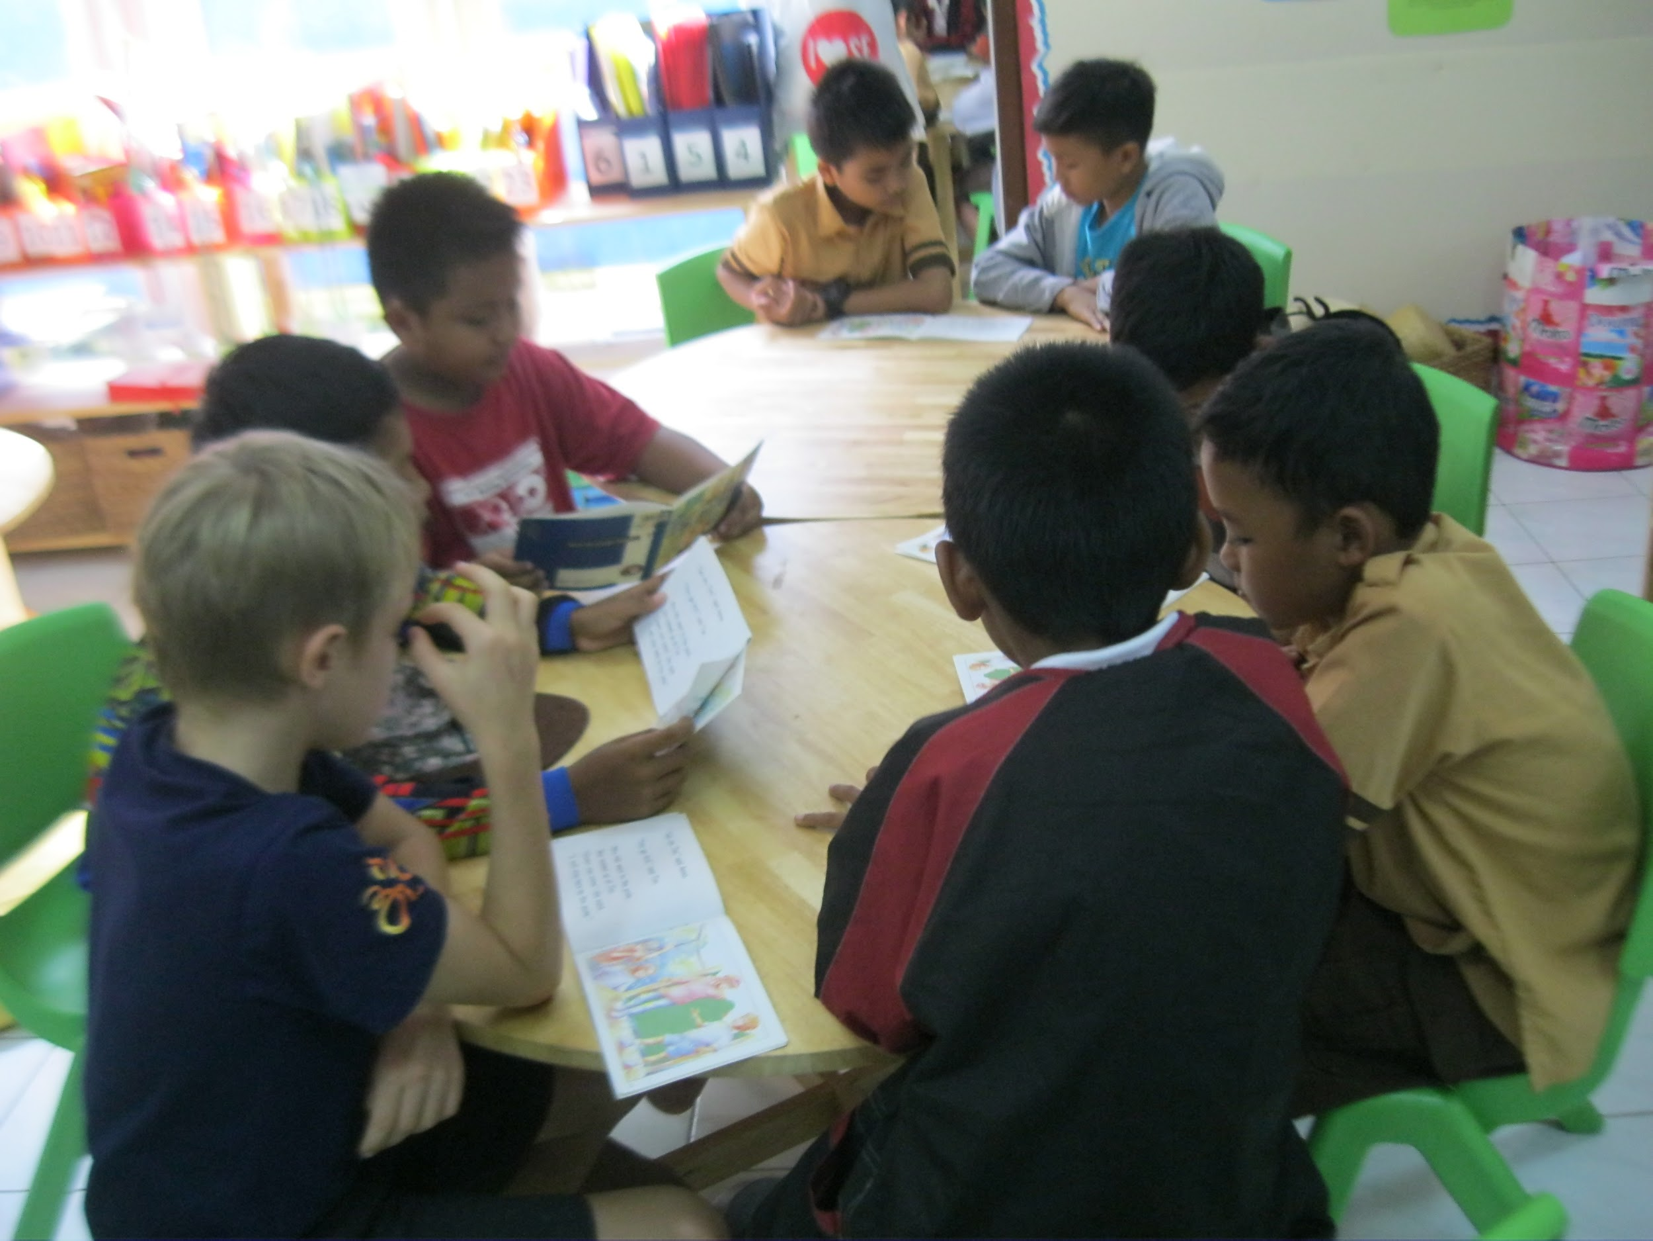
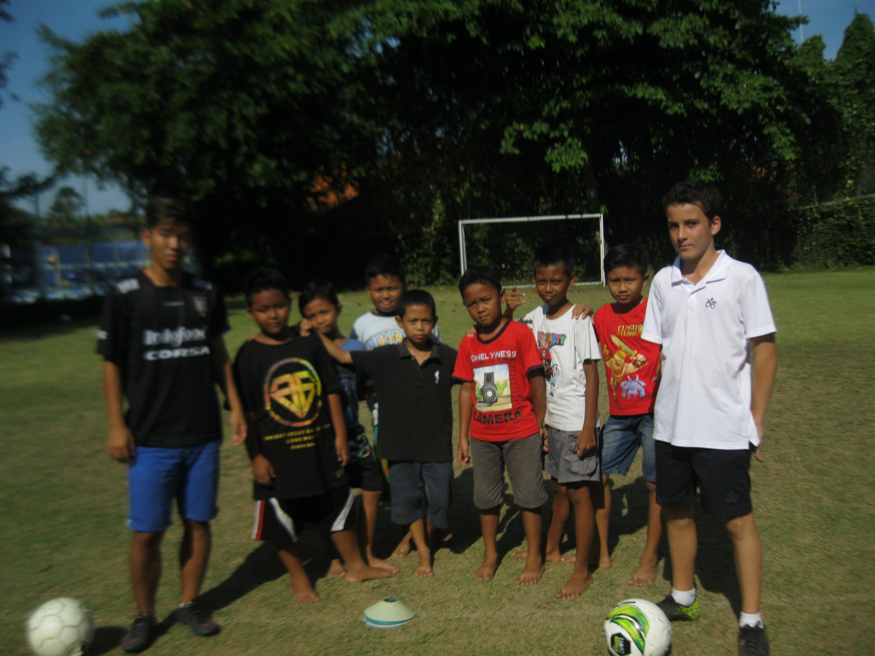
Taman Bacaan Reading Buddies
Instructor | Ibu Ketut Radnyanawati & Ibu Yunita Reny
Description | Come share your skills and compassion with the local community from Taman Bacaan group through a reading buddies activity! We will be engaging and supporting the local kids by reading and storytelling from books to improve their competence in English
Pillar | Community Service
Max. Participant | Open
Day & Time | Friday from 3-4 pm
Applicable Grade | Grade 3-12
Cost | n/a
Location | Taman Bacaan Room

Slide 44
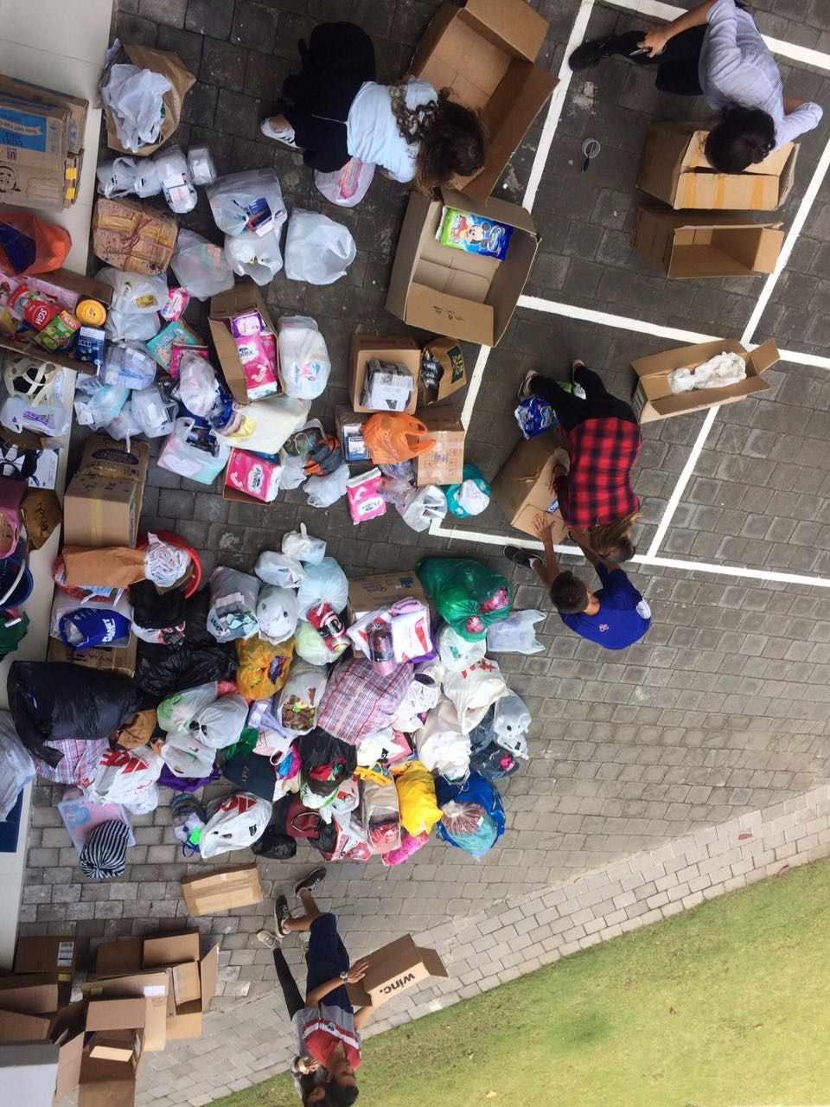
Relief Team
Instructor | Mr. Brown
Description | To establish and help people both inside and outside of our community
Pillar | CAS/Service
Max. Participant | 20
Day & Time | Friday from 3:00 - 3:30 pm Thursday lunch time
Applicable Grade | Grade 6-12
Cost | n/a
Location | Room 10

Slide 45
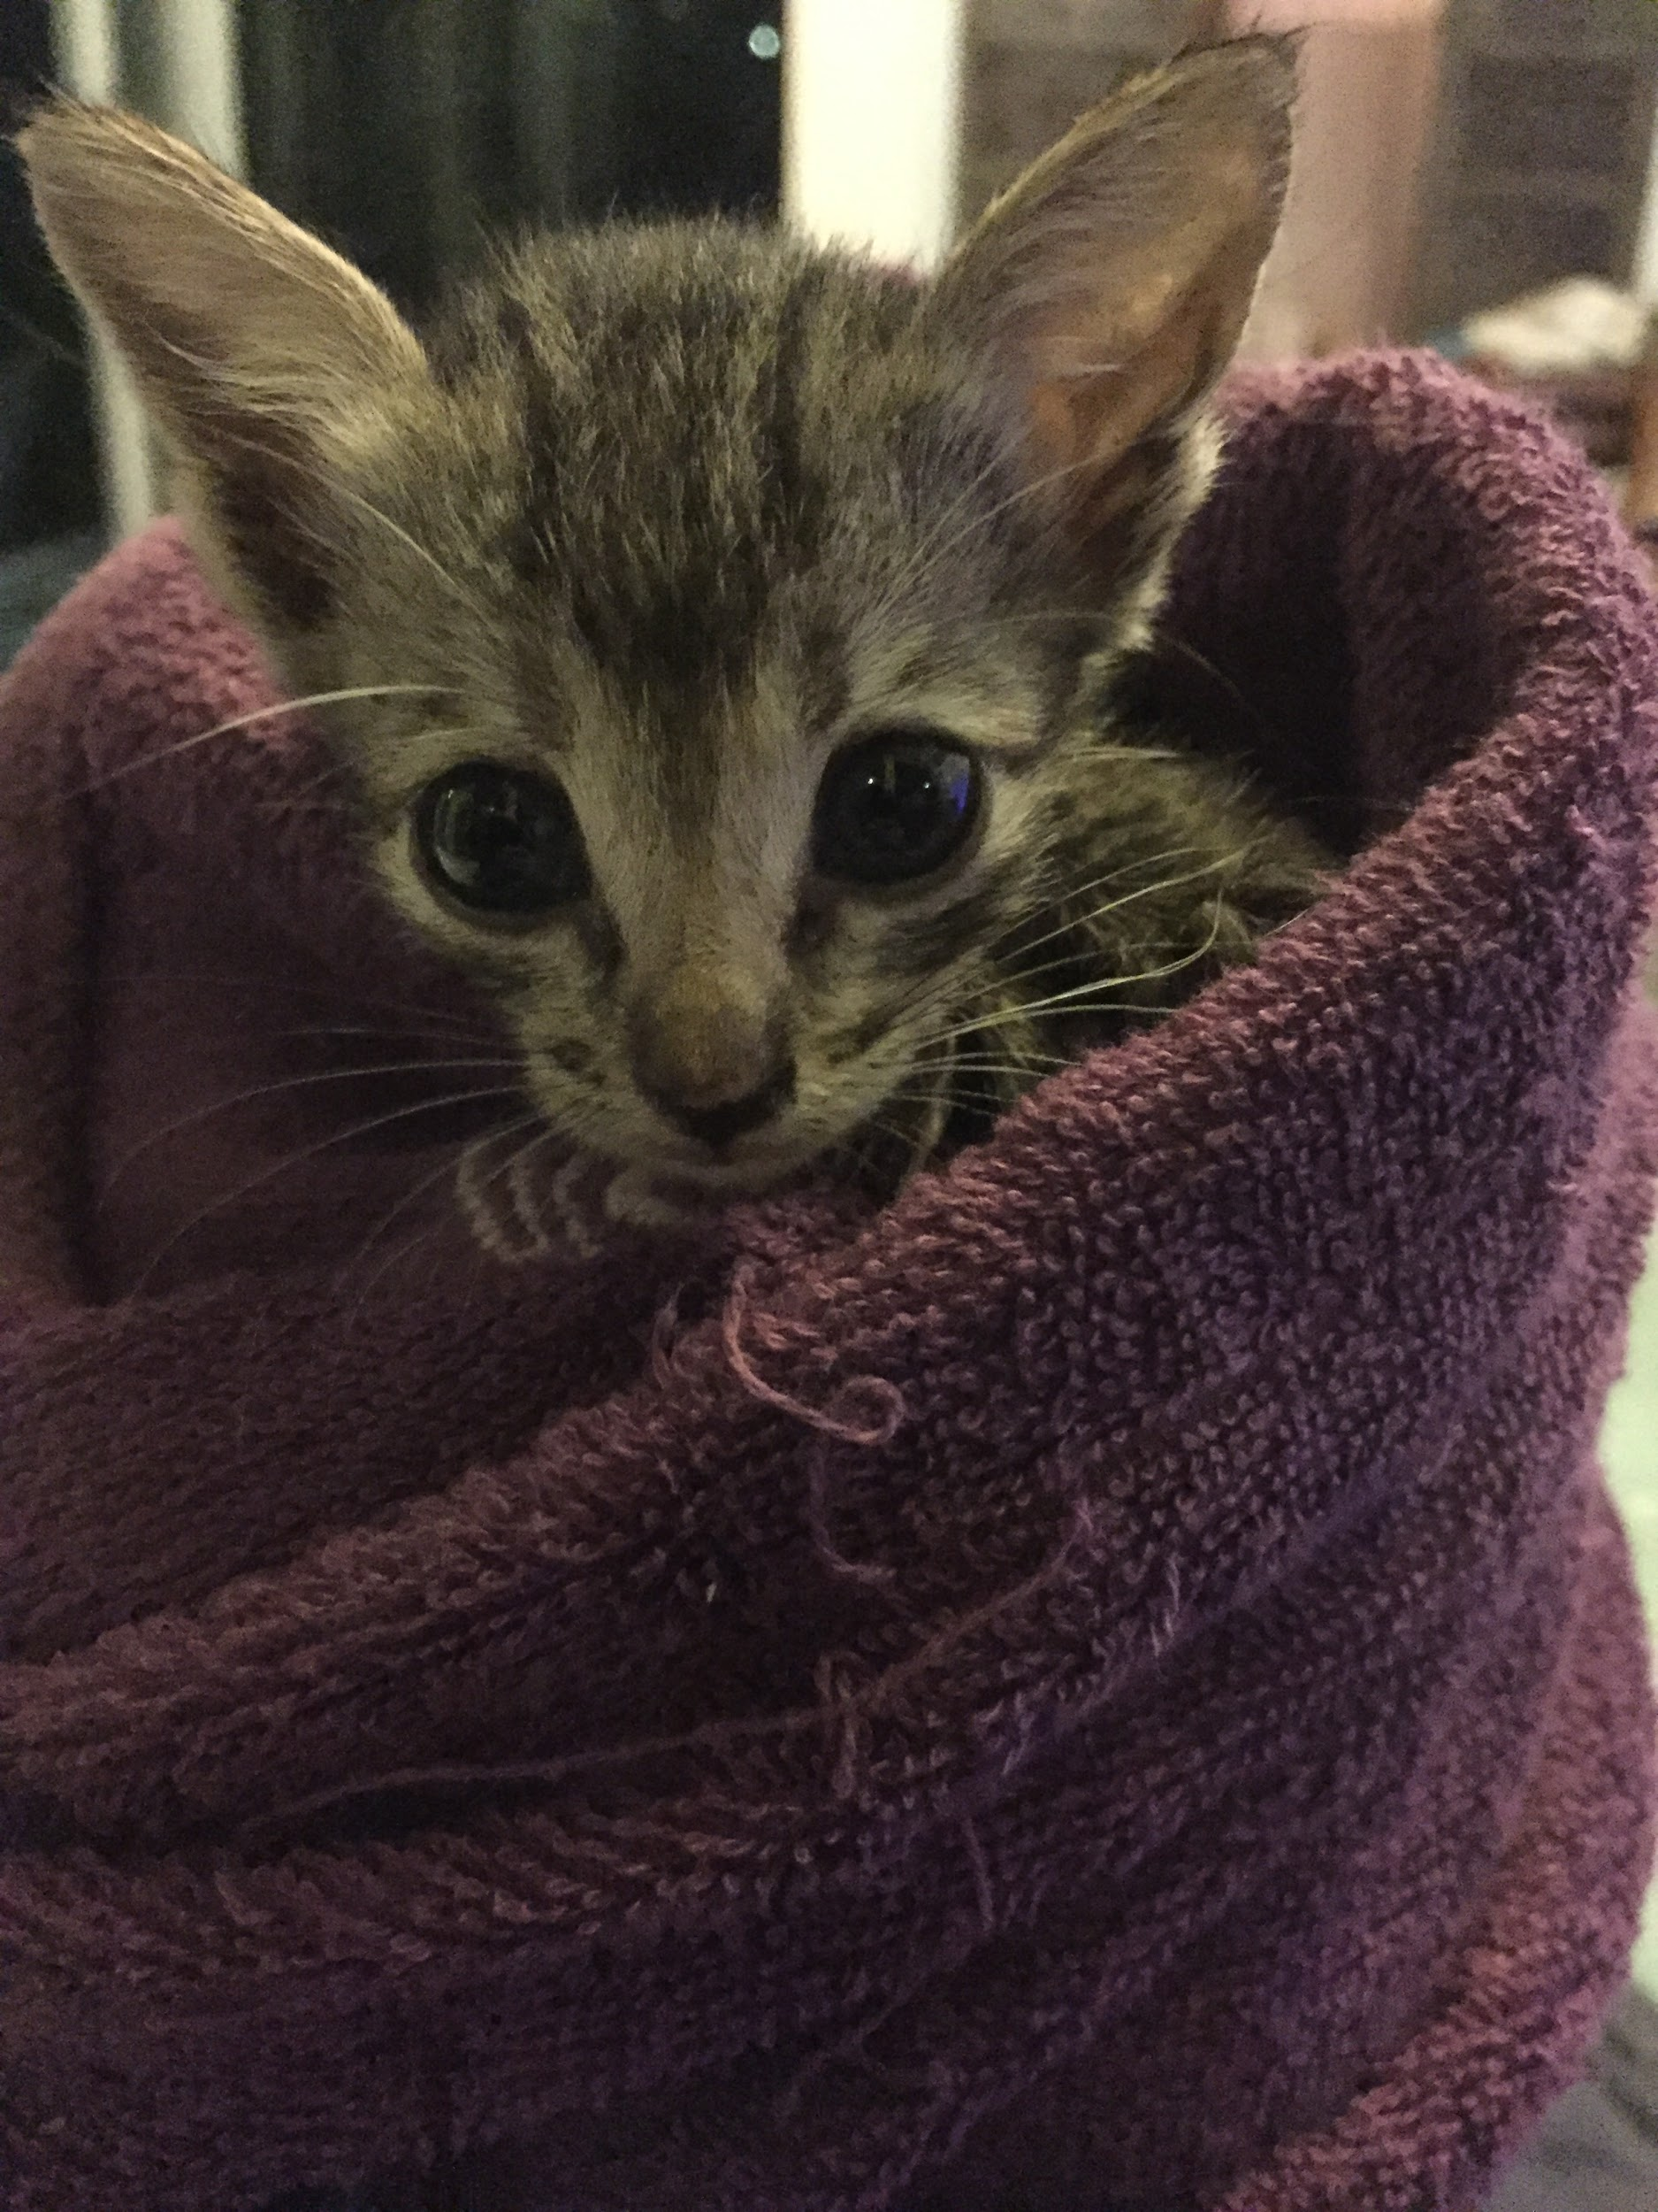
BIS Pet Guardians
Instructor | Mr. Brown
Description | To establish and run a program to trap, neuter, vaccinate and return/rehome stray cats to improve the lives of cats and alleviate overpopulation of stray cats in Bali.
Pillar | CAS/Service
Max. Participant | 10
Day & Time | Thursday from 3-4 pm
Applicable Grade | Grade 6-12
Cost | n/a
Location | Room 10

Slide 46
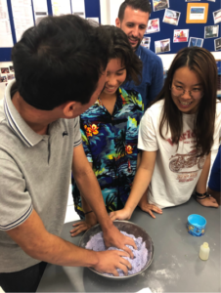
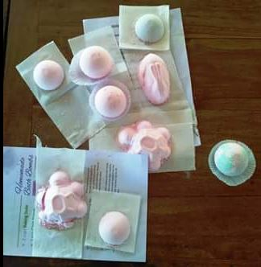
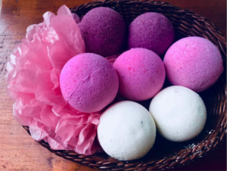
Bali Bath Bombs
Instructor | Mr. Brown
Description | Ongoing student-led business tied in with Business Management and CAS. Sevice activity to aid the local community at Les Village
Pillar | CAS/Service
Max. Participant | 10
Day & Time | Monday from 3-4 pm
Applicable Grade | Grade 6-12
Cost | n/a
Location | Room 10

Slide 47
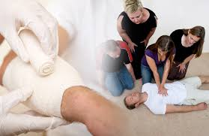
Bali First Aid
Instructor | Ibu Surya (school nurse)
Description | To establish a First Aid training program open to students, parents and teachers of the BIS community. Our mission would be to hold weekly trainings with the Nurse where by the end of the training sessions we would earn our first aid certificates with the guidance of Penta medica.
Pillar | CAS/Service
Max. Participant | 10
Day & Time | Tuesday from 3-4 pm
Applicable Grade | Grade 6-12
Cost | n/a
Location | TBC

Slide 48
The Green Team
Instructor | Ms. Quinn
Description | Support green practices in the school, through environmental changes, ethical practices and making BIS and the community a more environmentally friendly space.
Pillar | CAS/Service
Max. Participant | 10
Day & Time | Monday from 3-4 pm
Applicable Grade | Grade 6-12
Cost | n/a
Location | Room 7

Slide 49
Vanguard (School Journalist Club)
Instructor | Ibu Putu Mustiari
Description | Develop writing skills and learn to write articles for school magazine. The topic being covered can be vary depending on the group decision. This club aims to publish one magazine per semester and then distribute it to the community.
Pillar | Creativity
Max. Participant | Open
Day & Time | Monday break and Wednesday from 3-4 pm
Applicable Grade | Grade 6-12
Cost | n/a
Location | Room 14

Slide 50
Cooking Club
Instructor | Ms. Canan Cermen
Description | Each of us had at least prepared their own food, be it ordinary scrambled eggs or cereal with milk, or even more serious recipes, like pasta, soup, meat and more. For our club you don’t even need to be able to cook, all you need is to have the desire to learn something new. During this activity, we will try to share our skills and help advance your knowledge in cooking. Also, we will not just simply cook, every week we will have our own themes and tasks. All recipes that we will prepare will be chosen by you, but you should also select the recipe based on the theme of the week, and of course on the ingredients. Although we know how to cook, it might not be Masterchef worthy, but it would still be delicious! If you are interested, please join us!
Pillar | CAS/Creativity
Max. Participant | 14
Day & Time | Thursday from 3-4 pm
Applicable Grade | Grade 8-12
Cost | Products cost IDR 100,000 / student
Location | Staff Room Kitchen

Slide 51
Secondary Drama Club
Instructor | Dr. Shepherd and Ms. Sarah Alborn
Description | `In the secondary drama club students will work together to produce a play for performance at the end of March 2019. This means that students must commit to two terms (term 2 & 3). This activity is open to all no experience necessary. It gives students the opportunity to develop collaborative skills, acting skills and have a lot of fun. If students wish to be part of the stage crew they are not required to sign up for the club, just contact Dr. Shepherd or Ms. A to express their interest! They will be needed nearer to the performance
Pillar | Arts
Max. Participant | 30
Day & Time | Friday from 3:00 - 4:30 pm
Applicable Grade | Grade 6-11
Cost | n/a
Location | MPR

Slide 52
Balinese Dance (Female)
Instructor | Ibu Dewi Prabayanthi
Description | Let's get to know more about Balinese culture through dancing. This after school activity will be fun as it gives you a new experience about dancing traditional dances. We will learn traditional dances from the basic which eventually will be performed on school events.
Pillar | Arts
Max. Participant | 14
Day & Time | Monday from 3:00 - 4:30 pm
Applicable Grade | Grade 6-10
Cost | n/a
Location | Room 14

Slide 53
Gambelan
Instructor | Mr. Andrews
Description | Experience performing on the antique gamelan set that resides in the secondary music room. Students will undergo gamelan training in the authentic Balinese style taught by Pak Wayan from our local banjar. The BIS gamelan ensemble often steps up to perform at important events within the BIS community.
Pillar | Arts
Max. Participant | Open
Day & Time | Monday lunch time
Applicable Grade | Grade 6-12
Cost | n/a
Location | Music Room

Slide 54
School of Rock
Instructor | Mr. Andrews
Description | Anyone who enjoys popular music & likes the idea of learning some songs and jamming with friends should be in this group. We get together in a casual setting and choose songs to play. Any instrument can be played in this group, but the most common ones would be guitar, bass, drums & vocal. See you there!!!
Pillar | Arts
Max. Participant | Open
Day & Time | Thursday lunch practice
Applicable Grade | Grade 6-12
Cost | n/a
Location | Music Room

Slide 55
Choir
Instructor | Mr. Andrews
Description | This group is a great opportunity for students to enjoy singing with their peers. The repertoire includes popular songs both modern and the classics, spanning across a wide variety of genres. The goal is to perform at BIS community events such as assemblies and celebrations etc. No experience required, just enthusiasm and a passion for singing.
Pillar | Arts
Max. Participant | Open
Day & Time | Wednesday lunch practice
Applicable Grade | Grade 6-12
Cost | n/a
Location | Music Room

Slide 56
BIS Music Academy
Instructor | Private Tutors
Description | Private individual music lessons with qualified instructors. The program offers lessons on piano, singing, guitar, bass, drums, violin, cello, flute, clarinet, and saxophone. Please consult http://musicacademy.baliis.net/ for more information or email Ibu Isti (Primary) or Mr. Andrews (Secondary)
Pillar | Arts
Max. Participant | Open
Day & Time | after school 3pm - each day, schedule to be confirmed with the appropriate tutors
Applicable Grade | Grade 6-12 (beginner to advanced)
Cost | IDR 100,000/30 mins lesson
Location | Studios in secondary music room and the junior music room

